Slide 1
Readers’ Advisory: What Should I Read Next?
Librarianship 101
Mississippi Library Commission
Shellie Zeigler
September 2020

Slide 2
What We’re Going to Cover
Definition of Readers’ Advisory
Why offer Readers’ Advisory
Appeal Factors
Novelist Database
Modifying Readers’ Advisory in COVID-19 times

Slide 3
What Are We Talking About?
Readers’ Advisory Services:
Finding the right book for the right person at the right time.

Slide 4
Connect your readers to authors, as well as other genres
Promote your library’s collection
You will learn your library’s collection better
Create lifelong patrons
It’s rewarding– to both you & the patron
Why Offer Readers’ Advisory?
Notes:
And it’s kinda fun matching the right book with the right person. PLUS: The library’s core function is to make books widely available and accessible in the community. Even as libraries expand their services and offer STEAM programming, community outreach, or civic engagement, that is no reason to treat books as an afterthought.

Slide 5
BREAK OUT SESSION!
Think about a book you really love (what happens in this books, who does what to whom, where is it set, etc.)
Next think about a couple other books you love
Do all the books have the same plot?

Slide 6
Themes
What happens in a book is PLOT.
What you love about a book is typically not PLOT, but THEME.
THEME Examples: Fish out of Water, Race Against Time, Conquering Fear, Opposites Attract, Troubled Marriage, etc.
Themes are short-hand for a type of book you like.

Slide 7
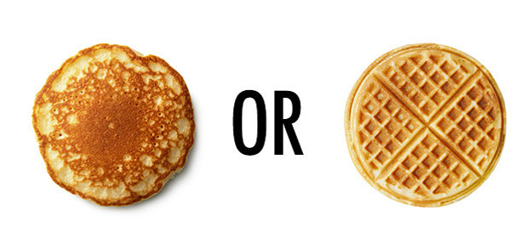
Appeal
Appeal describes the “feel” of a book.
It’s generally what sells a book and why one chooses a book over another.
Appeal often explains why a reader enjoys the books they read.
Notes:
Handout! Example: I like fast-paced, women as main characters . But I tend to like a dark tone with the female lead always coming out ahead. The setting doesn’t usually matter to me.

Slide 8
Appeal Factors
Pace
Storyline
Tone
Character
Writing Style
Themes

Slide 9
How do you offer Readers’ Advisory Service?

Slide 10
Direct & Indirect Readers’ Advisory
Interviews
One-on-One Chats
Displays
Programming (Book Discussion, Author Visits, Book Talks)
Print Media (Printed book lists, Emailed Review lists, Bookmarks)
Social Media, Blogs, Library’s website

Slide 11
Readers’ Advisory Interview
Most common form of Direct Reader’s Advisory
Ask reader to describe a book they like
Listen to what they say (Listen for “feel” or “themes” rather than plot points)
When a reader is describing a book it will trigger qualities (appeal factors) that they likes in books
Goal is to make the RA service conversational, not transactional

Slide 12
Interview Tips
It’s a conversation, not a transaction
Never assume reading tastes or preferences
Don’t speak “librarian” to patrons
Relax! Play each interview by ear
“What are you in the mood for?”
“What have you read lately that you liked” (or “What have you read that you did not like?”)
Is there anything you want to change about your reading habits?

Slide 13
Indirect
Definition: No live, direct contact between reader and reader’s advisor
Benefits
Book Displays, Bookmarks, Website
E-Newsletter, social networking, online book clubs, targeted marketing

Slide 14
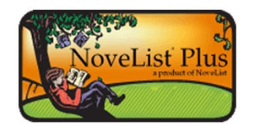
NoveList
Paid database (Magnolia)
Database of Fiction (Non-Fiction included with Novelist Plus)
Created SPECIFICALLY for Readers’ Advisory
Notes:
Demonstrate!

Slide 15
ADAPTING WITH COVID-19
Virtual book talks and recommendations
Form-Based Readers’ Advisory
Newsletters
Virtually provide book titles by theme

Slide 16
Tips
Collection
Get to know your collection
Talk
Talk to your peers about what they read
Read
Quick read books in genres that you do not normally read
Novelist
Become comfortable with Novelist

Slide 17
Helpful Tools
Webinar: How to Judge A Book By Its Cover https://www.youtube.com/watch?v=F24mpSrOJsc
Can you read a book in 10 minutes?
https://deweydivas.blogspot.com/2014/09/can-you-read-book-in-10-minutes.html?m=0
Fantastic Fiction
http://www.fantasticfiction.co.uk
Kitchen Sink RA
www.kitchensinkra.com

Slide 18
Project Ideas
Start a Readers’ Advisor binder, filled with suggestions for genres and titles.
Create a display focused on an author or theme (i.e. If you like “fish out of water” books, you may like these titles).
Talk to your Director about starting a form-based Readers’ Advisory Service.
Become comfortable with Novelist and do a training for your peers.

Slide 19
Contact Information
Shellie Zeigler
Library Consultant
601.432.4123
szeigler@mlc.lib.ms.us

