Slide 1
Books for the Young and the Young at Heart November 2018 Mississippi Library Commission

Slide 2
Picture Books

Slide 3
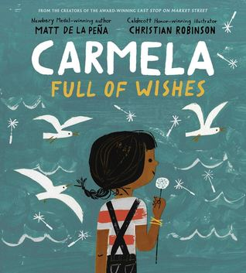
Carmela Full of Wishes by Matt de la Peña and Christian Robinson “Carmela’s journey of wishing, waiting, and wanting resonates on many levels; an important addition to bookshelves everywhere.” School Library Journal, starred review

Slide 4
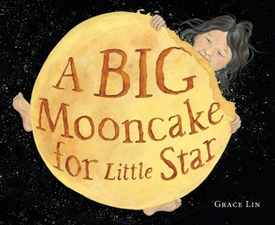
A Big Mooncake for Little Star by Grace Lin “The relationship between Little Star and her mother offers a message of empowerment and reassurance.” School Library Journal, starred review

Slide 5
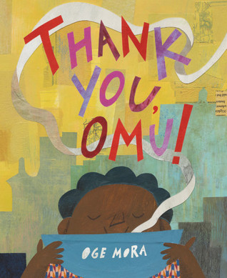
Thank You, Omu! by Oge Mora "A memorable tale of community and the unexpected rewards of sharing.” School Library Journal, starred review

Slide 6
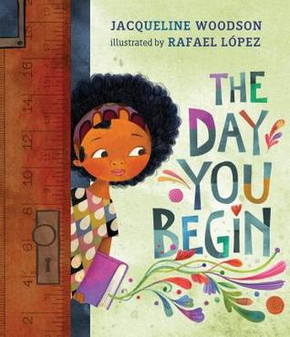
The Day You Begin by Jacqueline Woodson and Rafael López “This reassuring, lyrical book feels like a big hug from a wise aunt as she imparts the wisdom of the world in order to calm trepidatious young children.” Kirkus Reviews, starred review

Slide 7
Middle Grade Books

Slide 8
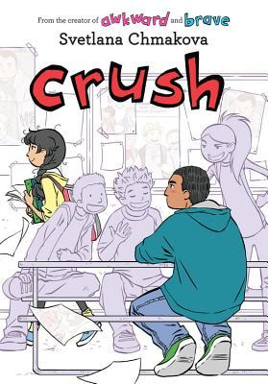
Crush Svetlana Chmakova The two previous comics in this adorable series for middle grades were included on ALA’s Great Graphic Novels for Teens list (2016 and 2018).

Slide 9
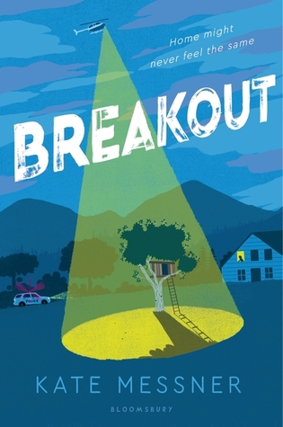
Breakout by Kate Messner "An accessible format and a unique focus on contemporary issues of criminal justice and racial bias make this an essential purchase." School Library Journal, starred review

Slide 10
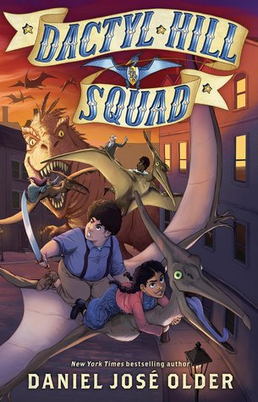
Dactyl Hill Squad by Daniel José Older "This high-energy title is perfect for middle graders, with its strong female protagonist (and) a fresh perspective on history…” School Library Journal, starred review

Slide 11
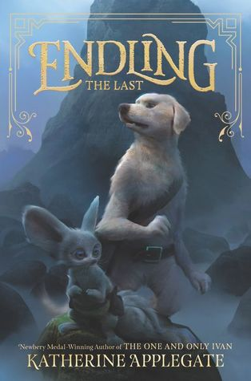
Endling: The Last by Katherine Applegate “This epic series starter is a bracing, propulsive read that will be a challenge to keep on the shelf.” ALA Booklist, starred review

Slide 12
Young Adult Books

Slide 13
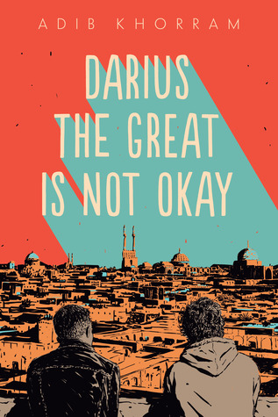
Darius the Great Is Not Okay by Adib Khorram “Darius is a well-crafted, awkward but endearing character, and his cross-cultural story will inspire reflection about identity and belonging.” School Library Journal, starred review

Slide 14
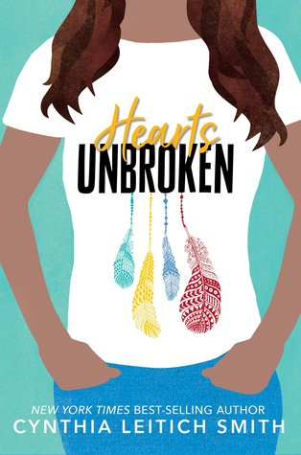
Hearts Unbroken by Cynthia Leitich Smith “Blending teen romance with complex questions of identity, equality, and censorship, this is an excellent choice for most collections.” School Library Journal, starred review

Slide 15
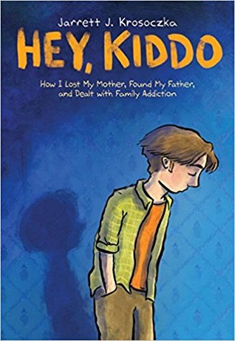
Hey, Kiddo by Jarrett J. Krosoczka “This nuanced graphic memoir portrays a whole family and tells a story of finding identity among a life’s complications.” Publishers Weekly, starred review

Slide 16
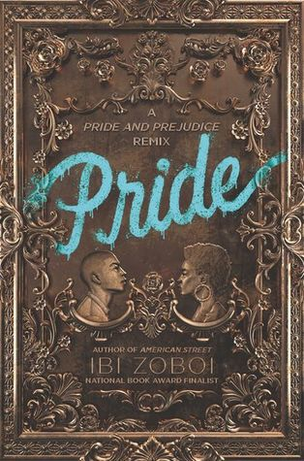
Pride by Ibi Zoboi “This excellent coming-of-age take on a classic belongs on all YA shelves.” School Library Journal, starred review

