Slide 1
Youth Titles You May Have Missed
May 2018
Mississippi Library Commission

Slide 2
Picture Books

Slide 3
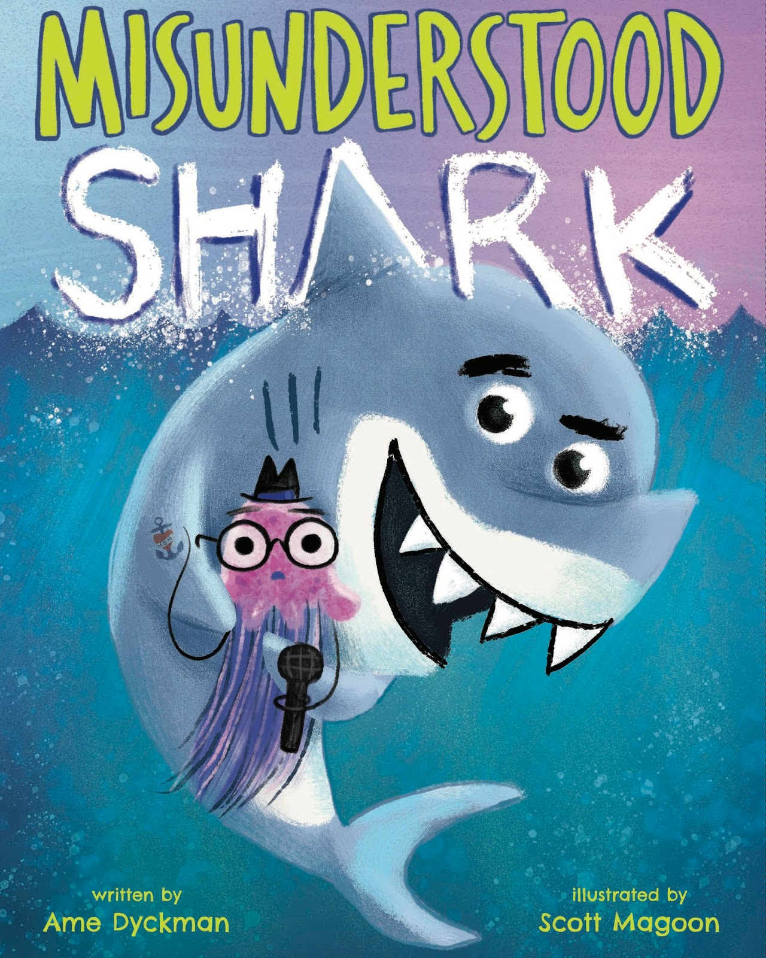
Misunderstood Shark by Ame Dyckman, illustrated by Scott Magoon
“The playful typography used for Dyckman’s rapid-fire dialogue makes her blooper-reel humor even funnier.” – Publishers Weekly
“Magoon's flair for underwater illustration also allows a shark's redemption and his prey's suspicion to both live on the page” - Kirkus
Notes:
The filming of an underwater tv show is interrupted by…a shark! But the shark wasn’t trying to scare them, he’s just misunderstood, right? And he wasn’t really going to eat that fish, he was just showing him his giant tooth…right? This deeply funny story will have your young patrons laughing aloud.

Slide 4
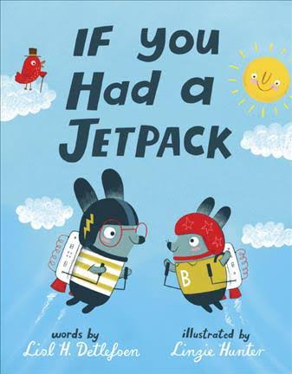
If You Had a Jetpack by Lisl H. Detlefsen, Illustrated by Linzie Hunter
“An energetic, crowd-pleasing read-aloud that can be revisited again and again” – School Library Journal
“This vivid picture book will leave kids longing for jetpacks, while taking off on their own flights of fancy” – Booklist
“Brightly colored animal characters and pages full of movement fit the playful tone and the theme of imagination.” - Kirkus
Notes:
Having a jetpack is fun! You can: take it to show and tell, visit your Nana, and even give your principal a ride! Join an inventive rabbit as he and his brother put their jetpacks to good use.

Slide 5
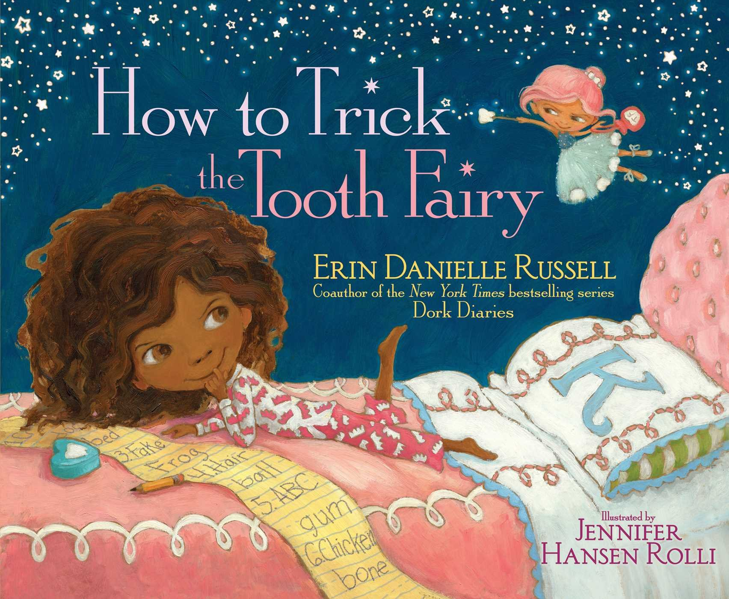
How to Trick the Tooth Fairy by Erin Danielle Russell, illustrated by Jennifer Hansen Rolli
“The illustrations are endearing and expressive.” – Kirkus
“Rolli humorously amplifies the escalating chaos in digitally enhanced, candy-hued watercolors.” – Publishers Weekly
Notes:
Kaylee loves pranks and she’s great at them—she’s even pranked Santa! But then she decides to take on the Tooth Fairy: a prankster extraordinaire! It starts with one small prank and then Kaylee and the Tooth Fairy find themselves in an ever-escalating prank war! Who is the Queen of the pranks? Will the two ever see eye to eye and decide to share the crown? This fun picture book is written by the coauthor of the bestselling Dork Diaries and will have your younger readers giggling at the prank escapades!

Slide 6
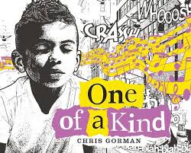
One of a Kind by Chris Gorman
“Readers whose unconventional tastes are at odds with the authorities will enjoy his energy and self-assurance.” – Publishers Weekly
Notes:
A punk-rock loving kid loves to express himself in unique ways. But he’s different from other people and sometimes that’s lonely. But it’s a big world and sometimes we can find people who are our kind of different.

Slide 7
Middle Grade

Slide 8

Rebound by Kwame Alexander
“An eminently satisfying story of family, recovery, and growing into manhood.” – Kirkus
“Librarians who delighted at Crossover’s popularity will be thrilled with this pitch-perfect follow-up.” – Booklist
New York Times Bestseller!
Notes:
In this prequel to the Newbery Medal winning The Crossover, Josh and Jordan’s dad Chuck takes center stage. How did he become the jazz loving basketballer his sons love and look up to? Kwame Alexander is a multiple award winning author whose books are wildly popular among middle grade readers. You want this book in your collection!

Slide 9
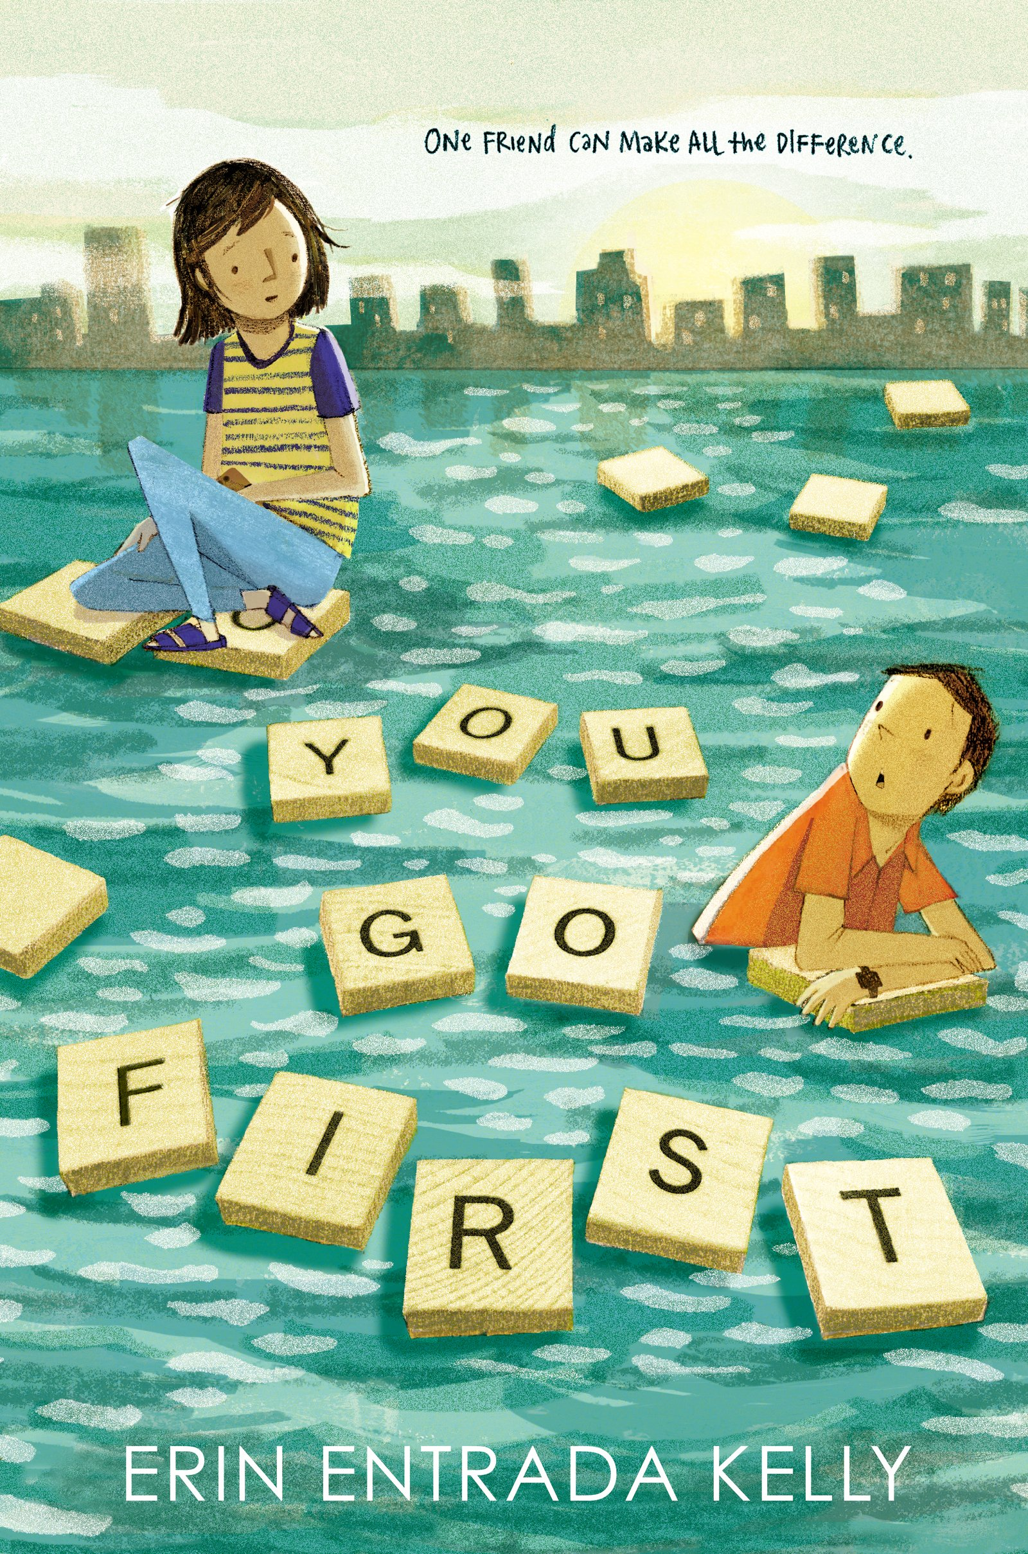
You Go First by Erin Entrada Kelly
“A well-crafted, entertaining call for middle schoolers to find their voices and remain accountable in shaping their own social spheres – Kirkus
“Kelly crafts an incisive portrait of friendship and resilience.” – Publishers Weekly
“Heartfelt and hopeful, this novel will encourage young readers to offer their hand in friendship to kids who, just like them, might be struggling.” – School Library Journal
Notes:
Charlotte and Ben live have connected online through a Scrabble game. They have a lot in common, but they live over a thousand miles apart. But over the course of a single week, they will intersect in unexpected ways as they both struggle through their lives in middle school. Newbery Award Winner Erin Entrada Kelly takes readers on a new adventure about friendship, middle school, and scrabble.

Slide 10
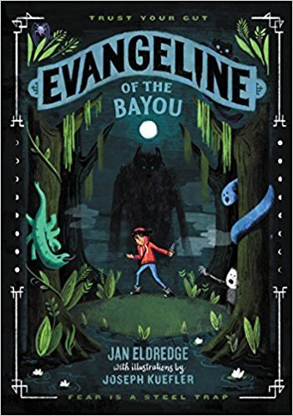
Evangeline of the Bayou by Jan Eldredge, with illustrations by Joseph Kuefler
“First-time author Eldredge delivers a finely tuned tale that integrates humor and suspense, light mythology, and magic. “ – Booklist
Notes:
Haunt huntress Evangeline is studying folk magic and learning to become a monster hunter. The only thing she has to do is prove to the council that she has the heart, and that she can step into her female ancestors’ line of huntresses. But when she and her grandmother are called to NOLA to pursue an unusual case, she uncovers a secret that might change everything.

Slide 11
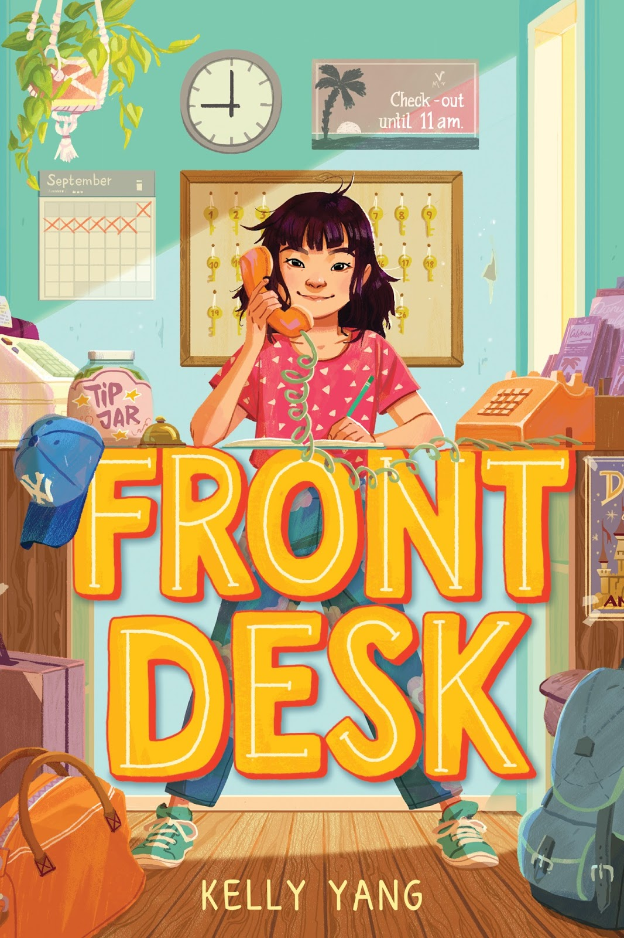
Front Desk by Kelly Yang
“Many readers will recognize themselves or their neighbors in these pages.” – Kirkus
“A swiftly moving plot and a winsome protagonist make this a first purchase for any collection, especially where realistic fiction is in demand.” – School Library Journal, starred review
Notes:
Mia Tang lives in a motel. She minds the front desk while her parents clean the rooms. But she has secrets. Like the fact that her parents hide immigrants in the empty rooms of the motel, and the owner doesn’t know. And like that she wants to be a writer, even though English isn’t her first language. It will take everything Mia has to get herself and her family through this year. With three starred reviews, this debut novel will is getting a lot of buzz and will appeal to a wide range of your young patrons.

Slide 12
Young Adult

Slide 13
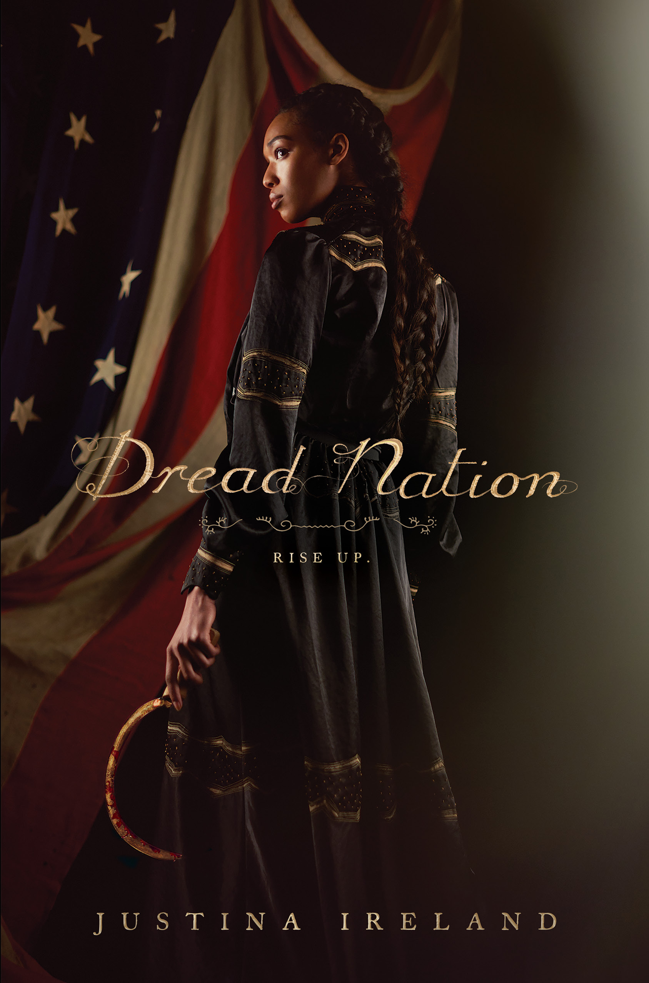
Dread Nation by Justina Ireland
“ A perfect blend of horrors real and imagined, perfect for public and school libraries and fans of The Walking Dead.” – School Library Journal
“Mounting peril creates a pulse-pounding pace, hurtling readers toward a nail-biting conclusion that inspires and will leave them apprehensive about what’s to come.” – Publishers Weekly
“With a shrewd, scythe-wielding protagonist of color, Dread Nation is an exciting must-read” – Kirkus
“This will take readers on a breathless ride from beginning to end.” – Booklist
New York Times Bestseller!
Notes:
Jane was born right before the bodies of the dead on Civil War battlefields rose. Now Native and black children must learn to fight the zombies and even being the daughter of a wealthy white woman can’t save Jane from that. She’s almost finished her training and ready to return home when families around Baltimore start to go missing and she’s caught up in the middle of a conspiracy that might cost her life. This one got a huge amount of pre-publication buzz and ended up on the NYT bestsellers list, so your patrons may already be excited for it!

Slide 14

From Twinkle, With Love by Sandhya Menon
“…The teen voice is pitch-perfect, and Menon navigates through Twinkle’s missteps and reparations with aplomb. A charming addition to the rom-com canon.” – Booklist, starred review
“Twinkle's relatable quandaries and her worthy professional aspirations give Menon's heroine solid appeal.” – Publishers Weekly
“A sweet, smart gem for most readers.” – School Library Journal
Notes:
Twinkle is an aspiring filmmaker with an opportunity to direct a movie for an upcoming Film Festival. She’s thrilled about the opportunity and because it’ll bring her closer to her longtime crush Neil. When a mystery man begins emailing her, Twinkle is definitely conflicted—her feelings have started to change over the course of the summer. Told in a breezy epistolary style with letters written to her favorite female filmmakers, to Twinkle With Love will make your YA readers smile from beginning to end.

Slide 15

Royals by Rachel Hawkins
“Hawkins maintains an appealing sense of humor throughout, while introducing enough conflict to drive the romantic narrative forward.” – Publishers Weekly
“A hilarious romp through a larger-than-life royal family fable.” - Kirkus
Notes:
Daisy Winters is a sixteen year old from Florida with red hair and a retail job. She also has a perfect older sister who’s basically engaged to the crown prince of Scotland. When she joins her sister across the pond, she’s caught between two Scottish boys trying alternately trying to make her press ready or make scandals. But Daisy might just change all the rules to suit herself.

Slide 16
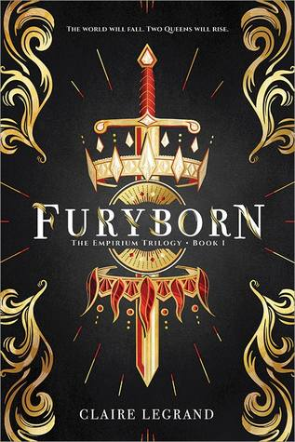
Furyborn by Claire Legrand
“ A good choice where Graceling by Kristin Cashore and Kate Elliott's Court of Fives are popular.” – School Library Journal
“Legrand excels at world building, deftly integrating the religion and history of this imaginary world into a dark yet rousing adventure story that combines passion and danger at every turn.” – Booklist
Notes:
Rielle and Eliana live a thousand years apart. Rielle is filled with magic and must prove her worth. Eliana is a bounty hunter just trying to survive. As their stories unfold, they end up in a cosmic war that spans millennia and their stories intersect in shocking ways. This start of a planned trilogy is perfect for your epic fantasy fans.

Slide 17
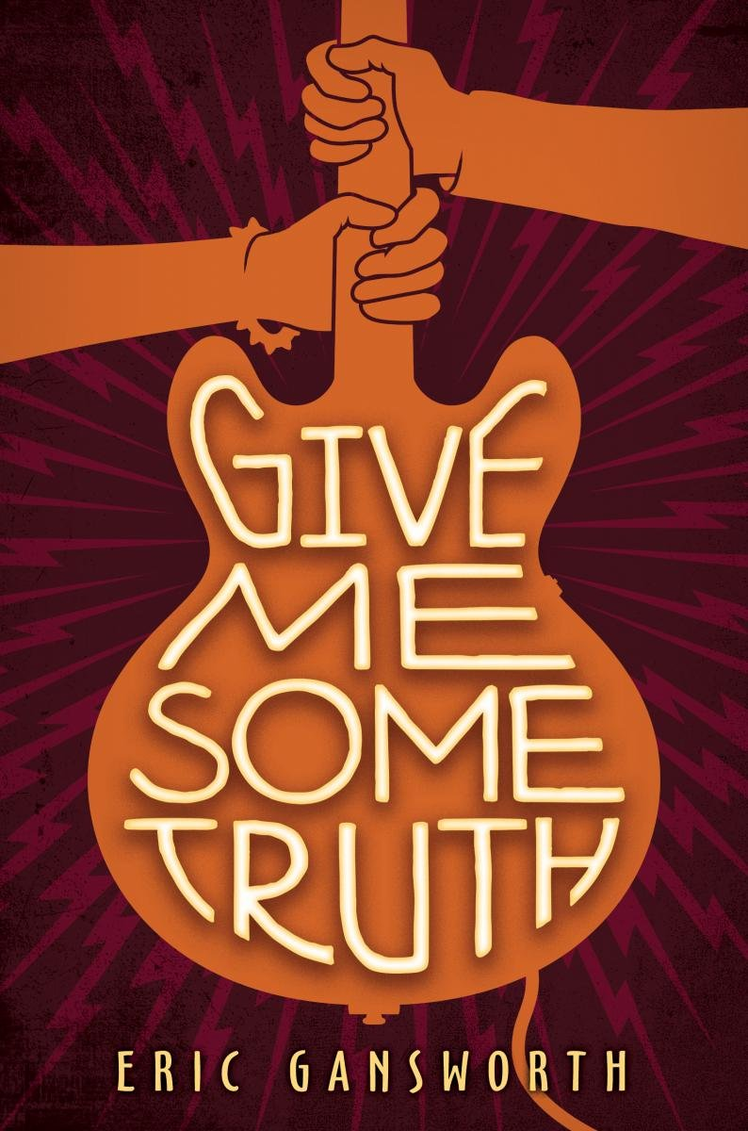
Give Me Some Truth by Eric Gansworth
“His characters are rich, well developed, and will stay with readers for a long time.” – School Library Journal
“Gansworth vividly captures the difficulties of reservation life and showcases his thoughtful protagonists' multidimensional interests and farreaching aspirations.” – Publisher’s Weekly
Notes:
Carson is getting ready for his senior year of high school and is ready to make his mark on the reservation and off—by winning the Battle of the Bands. A small thing like a lack of an actual band won’t get in his way. Maggi has just moved back to the reservation with her family and she’s looking to make some big changes, too. Carson and Maggi and their friend Lewis handle big changes, lots of music, and first love in this novel by Native Author Gansworth.

Slide 18
Ally Watkins
awatkins@mlc.lib.ms.us

