Slide 1
Picture Books
Ally Watkins
Mississippi Library Commission

Slide 2
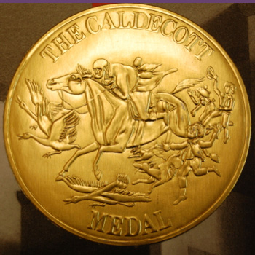

Awards
Caldecott Medal (America)
Kate Greenaway Medal (UK)

Slide 3
@ Your Library
In your collection
Displays
Programming

Slide 4
Booktalks

Slide 5

Awake Beautiful Child by Amy Krouse Rosenthal, ill. By Gracia Lam

Slide 6

Mixed Me by Taye Diggs, ill. By Shane W. Evans

Slide 7

More caps for Sale by Esphyr Slobodkina with Ann Marie Mulhearn Sayer

Slide 8

Big Bear LITTLE CHAIR by Lizi Boyd

Slide 9

Dinosaur Rocket by Penny Dale

Slide 10

The Story I’ll tell by Nancy Tupper Ling, ill. By Jessica Lanan

Slide 11

The Guild of Geniuses by Dan Santat

Slide 12

Be a Friend by Salina Yoon

Slide 13

Frankencrayon by Michael Hall

Slide 14
awatkins@mlc.lib.ms.us
Ally Watkins

