Slide 1
Audiobooks
Ally Watkins
Mississippi Library Commission

Slide 2
Some Stats
Audiobook sales have increased 20% in the last year
Audiobook sales are a $1.47 billion annual industry
25,787 audiobook titles were published in 2014
Source: The Audio Publishers Association

Slide 3
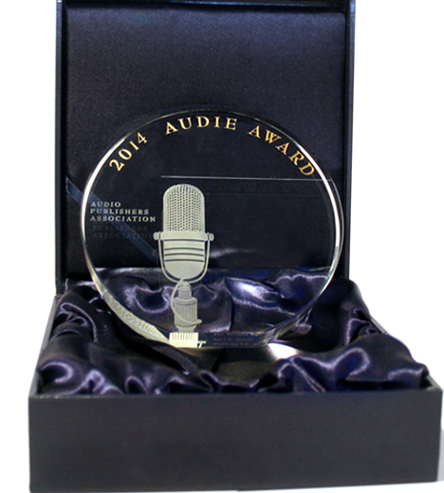

Major Awards
Audie Award
Odyssey Award

Slide 4

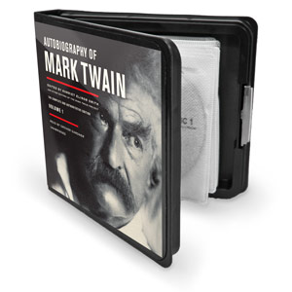
Formats
Audiobook CD
MP3 CD

Slide 5
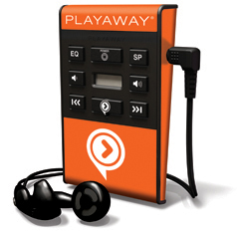
Formats
Playaways

Slide 6
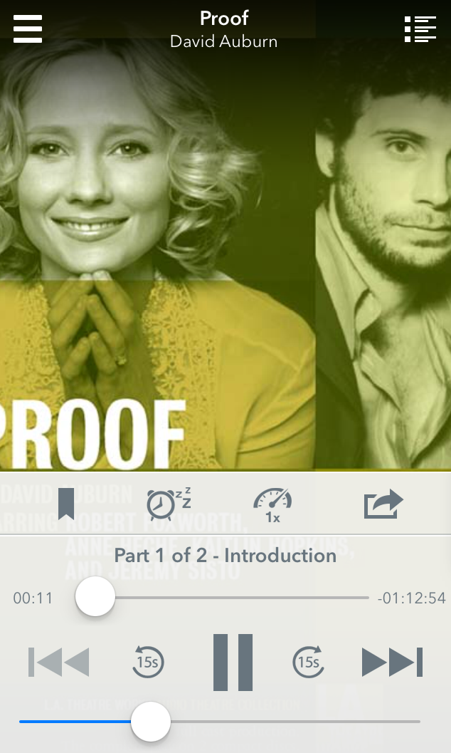

Digital Formats
Overdrive
Axis360

Slide 7
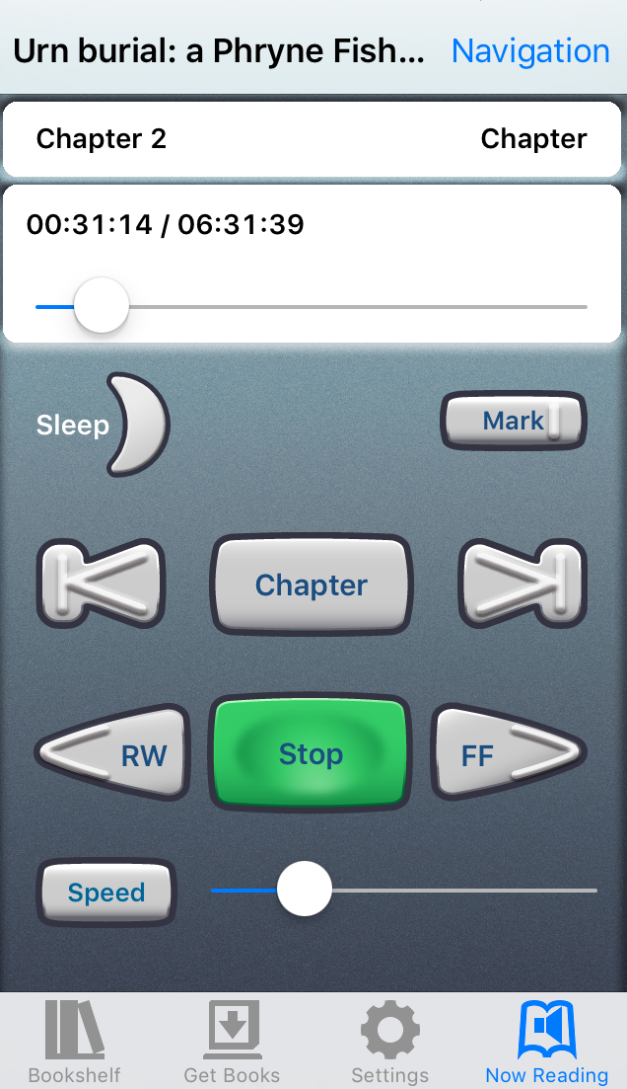
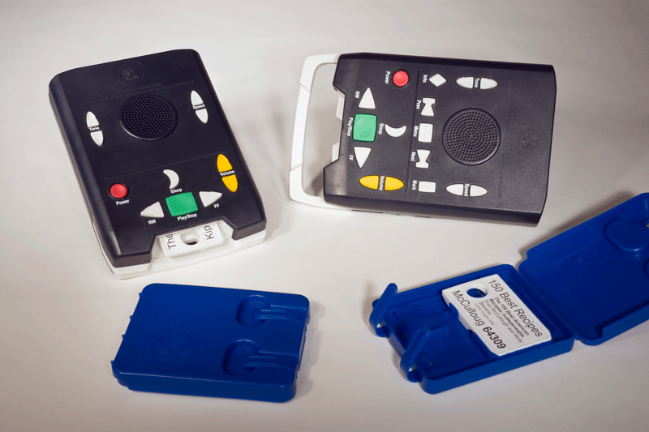
Talking Book Services
For more information, contact Talking Book Services Director Shellie Zeigler at szeigler@mlc.lib.ms.us.

Slide 8
Ally Watkins
awatkins@mlc.lib.ms.us

