Slide 1
Spanish for Librarians
and how to integrate Spanish into your library
Hosted by the Mississippi Library Commission
Presented by Caleb Stephens

Slide 2
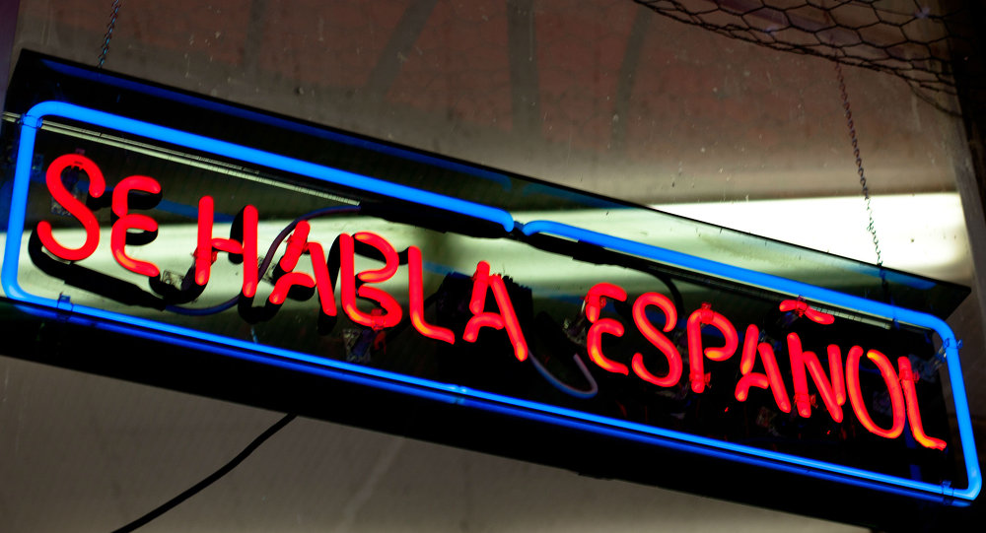
Why Spanish?
1) Spanish speakers in the US
52.6 million fluent speakers
2) Spanish learners
7.8 million students

Slide 3
Section 1: Basics of the Spanish Language
1. The alphabet
2. Numbers
3. Pronouns
4. Basic Phrases

Slide 4
El alfabeto
A a
B b
C c
D d
E e
F f
G g
H h
I i
J j
K k
L l
M m
N n
Ñ ñ
O o
P p
Q q
R r
S s
T t
U u
V v
W w
X x
Y y
Z z
"ca" , "co" , "cu"
"ci" , "ce"
"ga" , "go" , "gu"
"gi" , "ge"
"ll" and "y"
"qui" , "que"
"s" and "z"
"gui" , "gue”
“güi” , “güe”
“j" ( "h" )
"b" and "v"

Slide 5
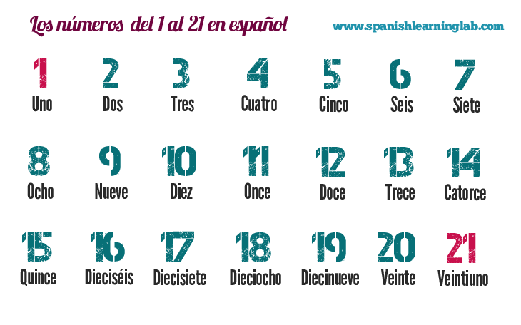
Los números

Slide 6
Los pronombres
Yo → I | Nosotros(as) → We
Tú → You (informal) | Vosotros(as) → Y'all (informal)
Usted → You (formal) | Ustedes → Y'all (formal)
Él → He | Ellos → They (males)
Ella → She | Ellas → They (females)

Slide 7
Las frases básicas
In groups of two, practice the dialogue found in your handout.

Slide 8
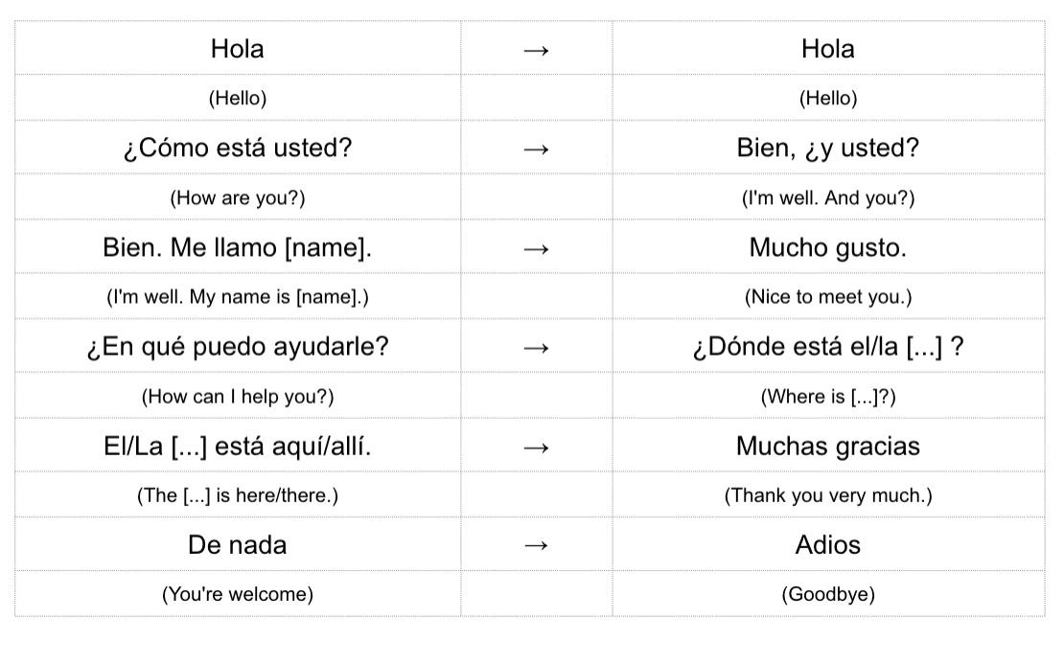
Diálogo de frases básicas

Slide 9
Otras frases

Slide 10
Section 2: Integration of Spanish into the Library
1. Providing basic information in Spanish
2. Programs for Spanish speakers
3. Cultural sensitivity

Slide 11
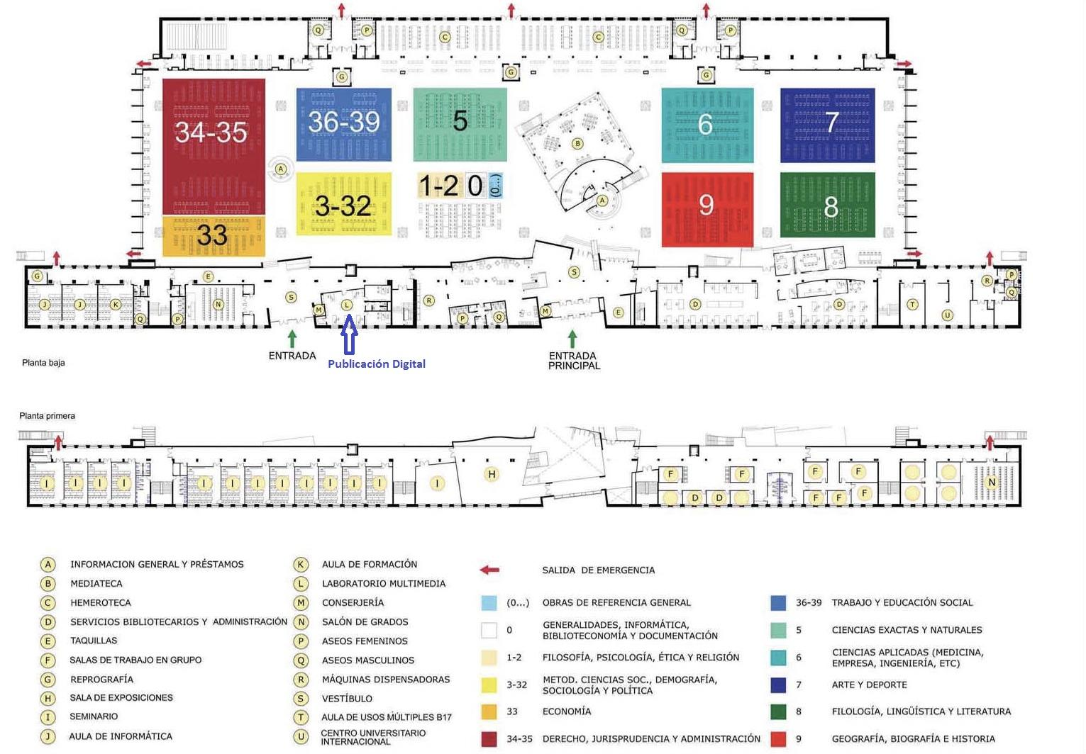
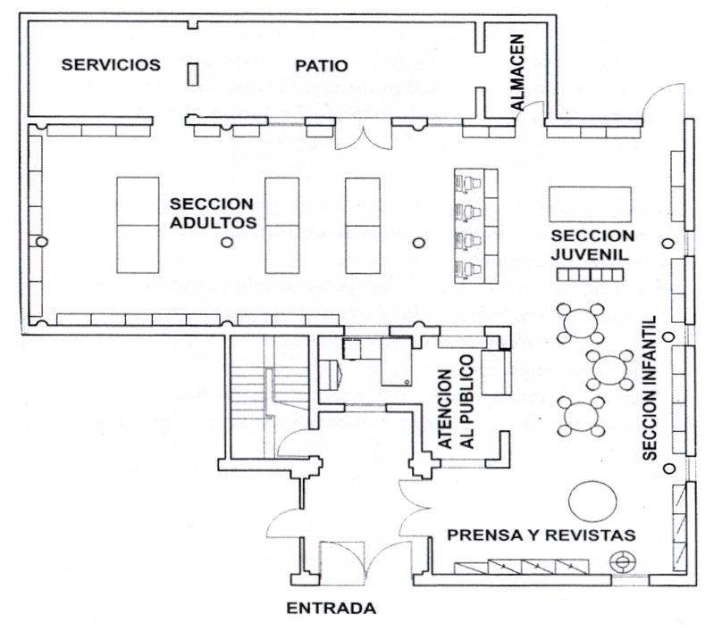

Slide 12
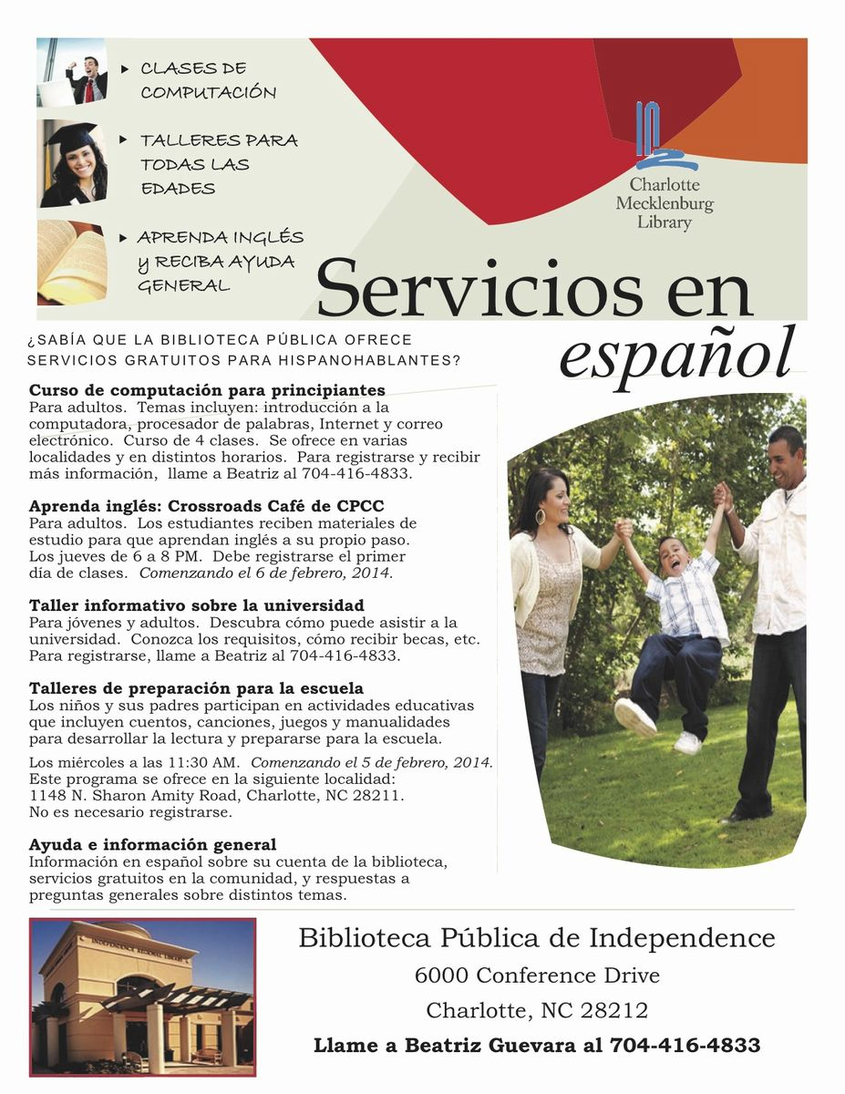

Slide 13
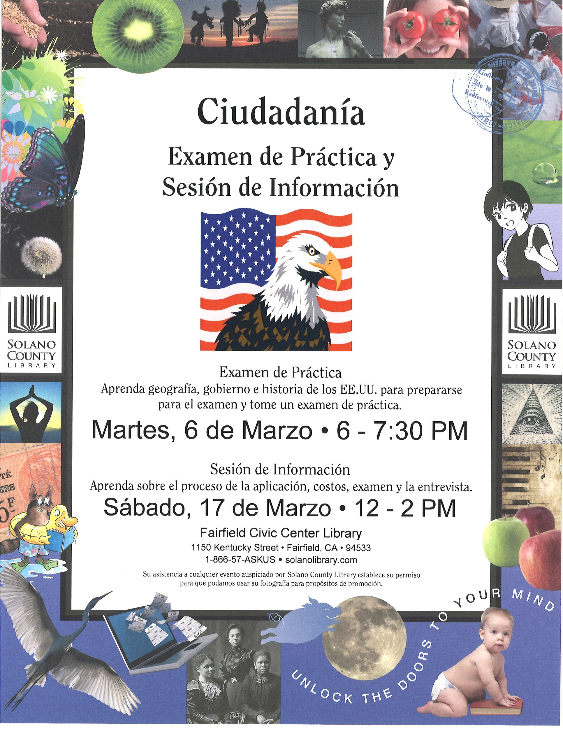

Slide 14
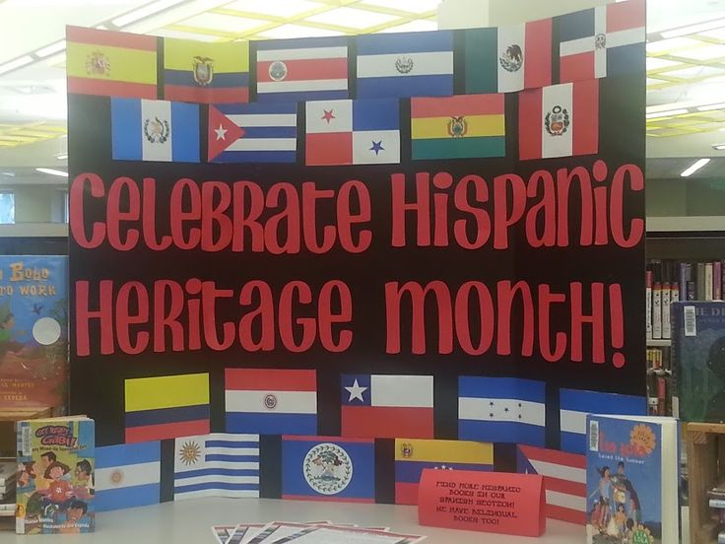

Slide 15
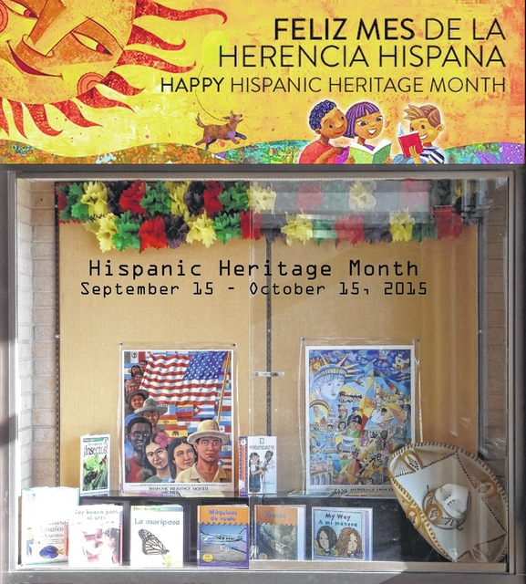
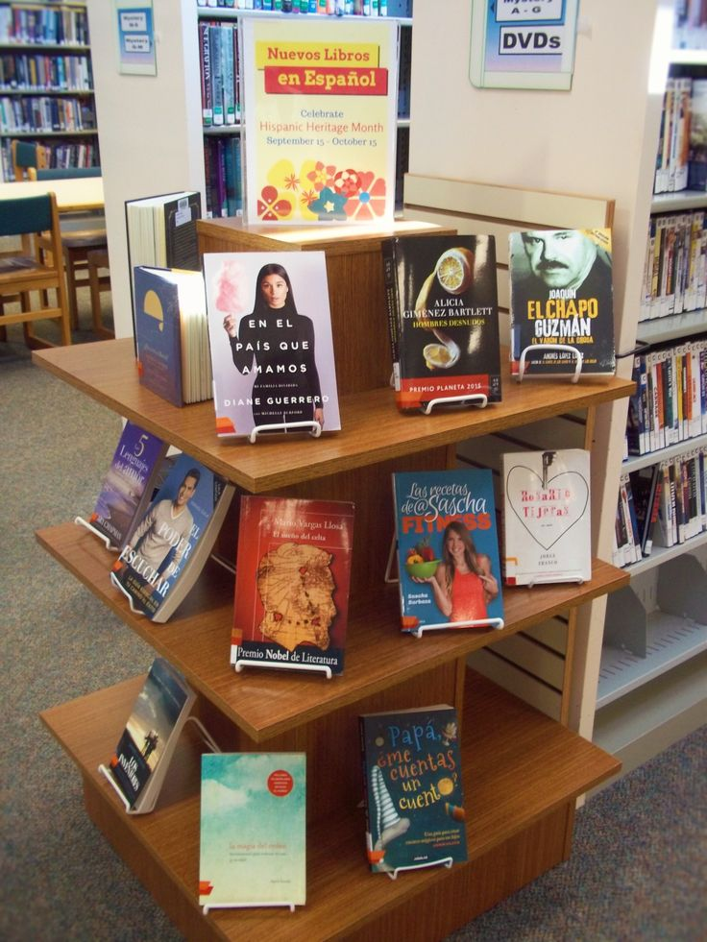

Slide 16
Contact information: Caleb Stephens castephens88@gmail.com

Slide 17
Thank you
Gracias

