Slide 1
Youth Titles You May Have Missed
Summer Library Program 2018

Slide 2
Picture Books

Slide 3
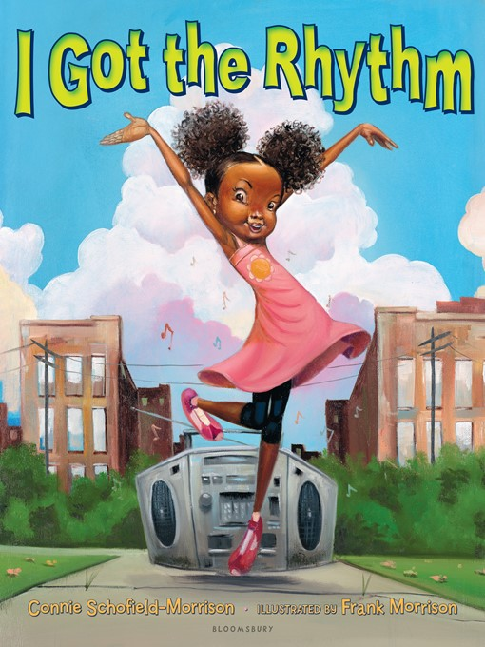
I Got the Rhythm by Connie SChofield-Morrison, illustrated by Frank Morrison
Notes:
A rollicking readaloud about a little girl who hears the music in the world around her, from street performers to nature sounds. She starts grooving to the beat, and then she gets up an impromptu dance—who will join in?

Slide 4
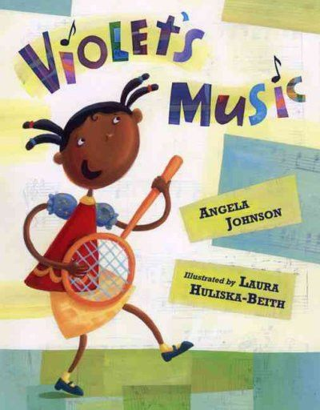
Violet’s Music by Angela Johnson, illustrated by Laura Huliska-Beith
Notes:
Violet loves music and she plays and sings whenever she gets a chance. But she’s constantly on the lookout for kids like her—kids that love music and want to play and sing all the time. Will violet find musical companions?

Slide 5
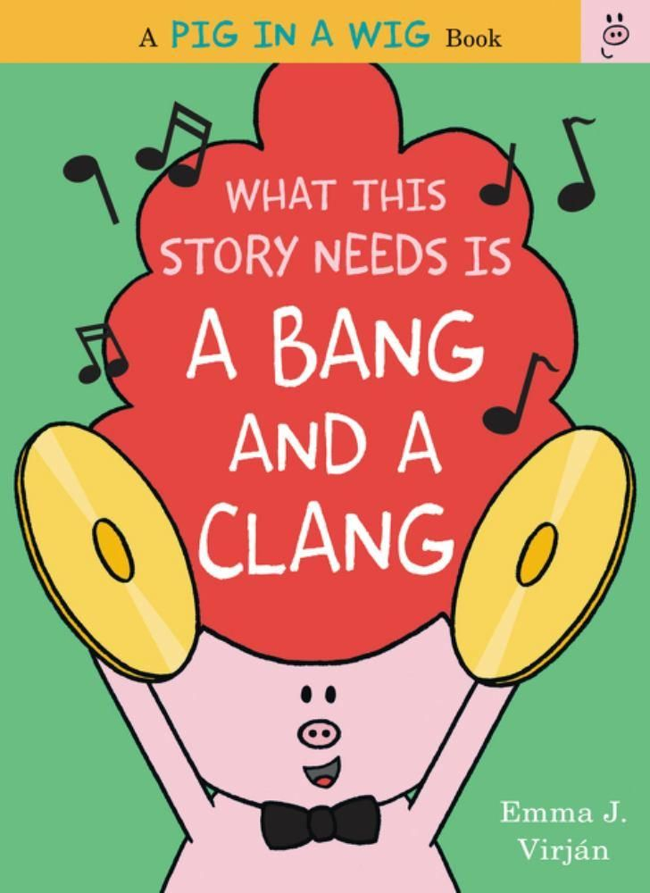
What this story needs is a bang and a clang by emma J. Virjan
Notes:
Part of the pig in a wig series, this story definitely needs a bang and a clang! This funny, bold readaloud with eye-catching colors and fun rhythmic text shows what happens when the pig in a wig wants to conduct the Pig in a Wig band!

Slide 6
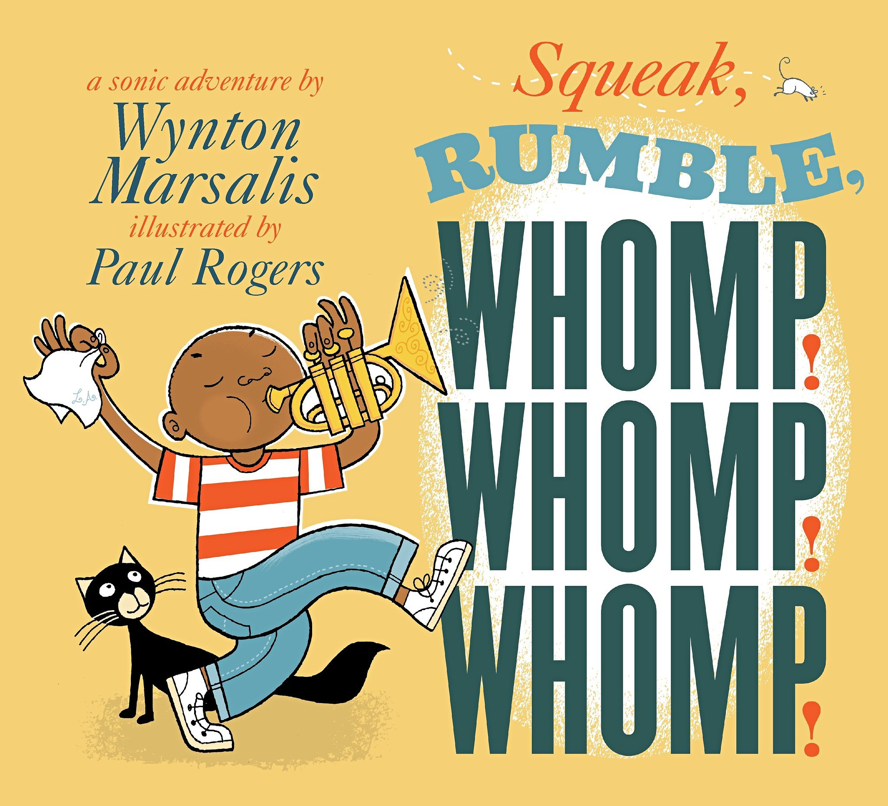
Squeak, Rumble, Whomp! Whomp! Whomp! by Wynton Marsalis, illustrated by Paul Rogers
Notes:
What’s that sound?? This question is answered many times over as the reader explores the busy sounds of a neighborhood—the squeak of a door, the rumble of trucks on the highway. Renowned jazz musician Wynton Marsalis and illustrator Paul Rogers take the reader—or listener—on a tour through the sounds that make up a life.

Slide 7

Ellie in Concert by Mike Wu
Notes:
Ellie’s friend Lucy the giraffe hasn’t been able to sleep over all of the noise in the zoo. Can Ellie help her friends turn the cacophony into a beautiful orchestra sound?

Slide 8

This Jazz Man by Karen Ehrhardt, illustrated by R.G. Roth
Notes:
This jazz man
He plays 1
He plays rhythm with his thumb
This jazz-inspired take on a classic rhyme features real classic jazz musicians on its pages, gorgeous colorful illustrations, and a hopping tune. Your kids will be singing along at storytime!

Slide 9
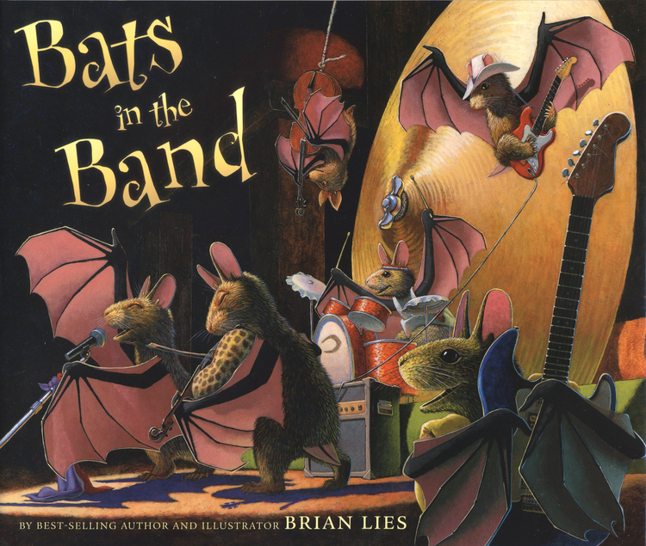
Bats in the Band by Brian Lies
Notes:
A lovely addition to Brian Lies’s Bats series of picture books, this one features bats flocking to a theater to hear the bat band make all kinds of beautiful music!

Slide 10
Middle Grade

Slide 11

Clayton Byrd Goes Underground by Rita Williams-Garcia
Notes:
A national book award finalist, this middle grade novel by acclaimed writer Rita Williams-Garcia comes the story of Clayton Byrd, a young boy who loves his grandfather and the blues music he makes. But when his grandfather dies, his mother forbids him from playing the blues. So he runs away from home in search of his grandfather’s band, hoping he can join them on the road.

Slide 12
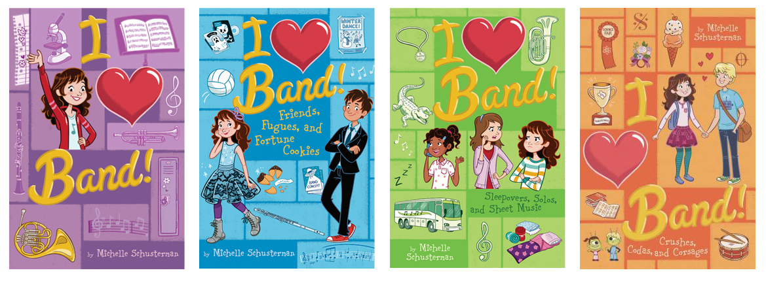
I Heart Band by Michelle Shusterman
Notes:
This adorable four-book series is about the ins and outs of middle school band. Your young readers, especially those that are looking forward to being in band themselves, will devour all of these whole!

Slide 13
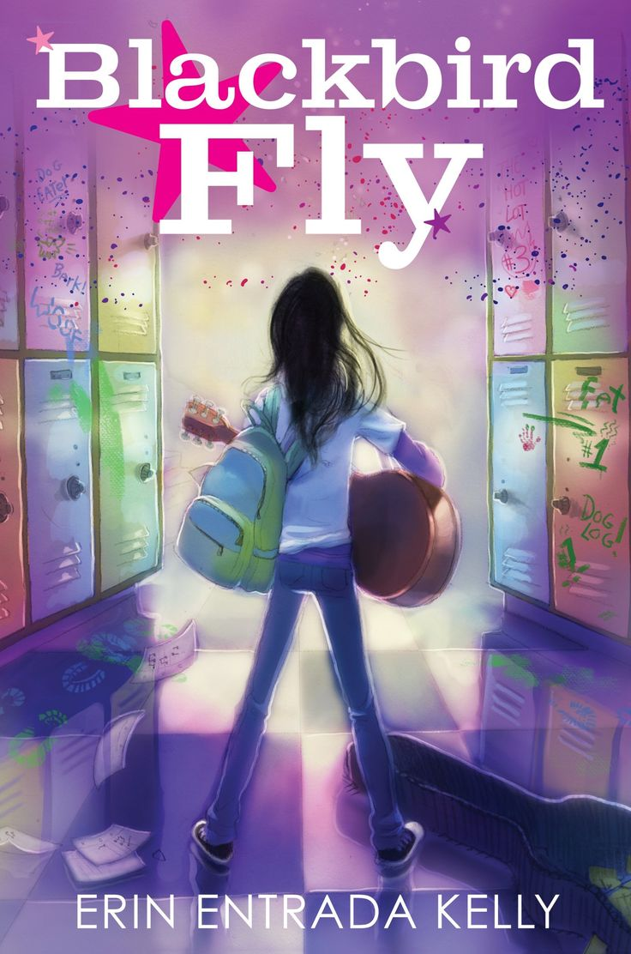
Blackbird Fly by Erin Entrada Kelly
Notes:
Apple’s life in middle school is tough. Her friends have turned on her, her Filipino mom is on her case for becoming “too American,” and she doesn’t know what to do. So she turns to music. If she can only save enough to buy a guitar and learn how to play, maybe she can change herself into something great, like a rock star. Maybe she can save herself. Or maybe she’ll meet some new friends who can convince her how special she is.

Slide 14
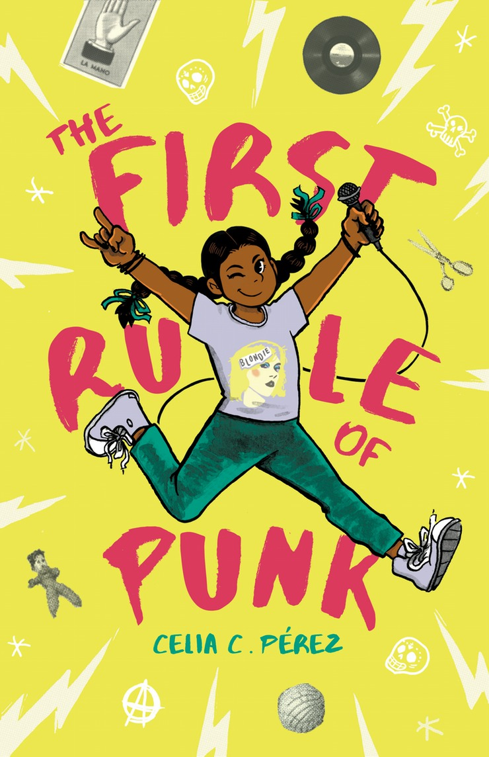
The First Rule of Punk by Celia C. Pérez
Notes:
Malu loves rock and punk music and zines. Will her move to a new city with her mom and away from her dad and his record shop be a disaster? Join Malu as she and some other like-minded misfits form a band and try to use music, art, and family to start to feel at home in her new place.

Slide 15
Young Adult

Slide 16
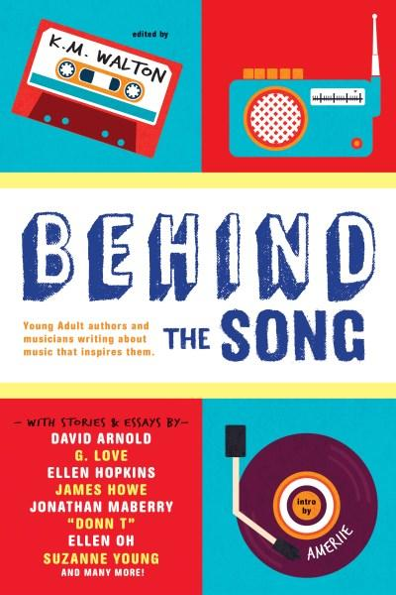
Behind the Song Edited by K.M. Walton
Notes:
In Behind the song, 14 acclaimed young adult authors and musicians wrote short stories and essays about the music that inspires them!

Slide 17

The Lucy Variations by Sara Zarr
Notes:
Lucy Beck-Moreau once had a very promising future as a concert pianist: before she even turned 14. A death and a betrayal had her walking away from the piano altogether, until two years later when her little brother’s new piano teacher seems like he wants to help her rekindle her love of music—just for herself. But can someone who was at that competitive level ever learn to love the music just for herself again?

Slide 18
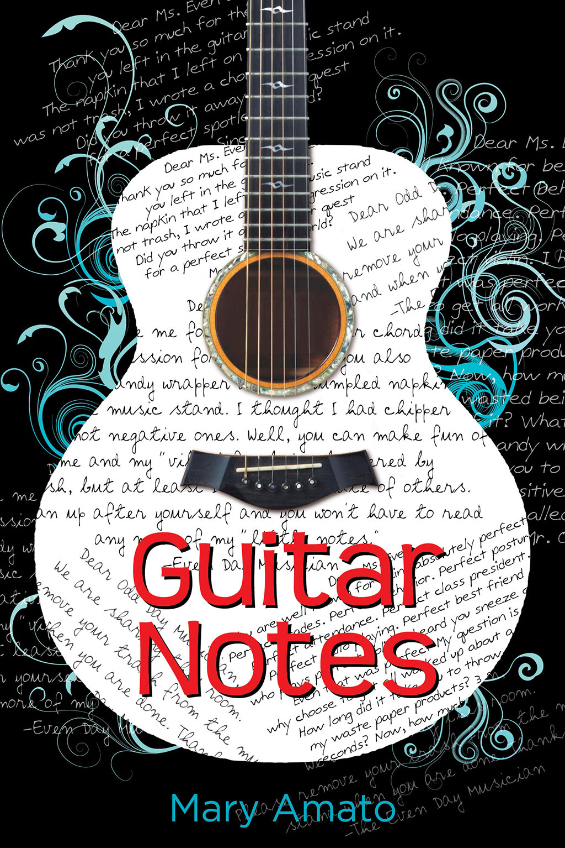
Guitar Notes by Mary Amato
Notes:
A boy who plays guitar only for himself and a girl whose skills on the cello have already brought some renown forge a friendship when they end up having to share the same practice room at school.

Slide 19

Virtuosity by Jessica Martinez
Notes:
Carmen’s entire life is the violin. And what she really wants is to win a prestigious competition. What’s standing in her way? Another violin player: Jeremy. So this would be an awfully inconvenient time to fall in love with him.

Slide 20
Ally watkins
awatkins@mlc.lib.ms.us

