Slide 2
Fluid Intelligence
FLUID INTELLIGENCE: the ability to think abstractly, reason, identify patterns, solve problems, & discern relationships.
Music, voice and drama lessons are also linked with abilities associated with fluid intelligence, such as working memory, perceptual organization and processing speed. (Parenting Sciences http://www.parentingscience.com/music-and-intelligence.html).
Studies show…Learning to play a musical instrument can raise children’s IQs and improving reading and social skills. Youth who take music lessons have slightly higher IQs, with the effects cutting across many different intellectual abilities, including verbal, mathematical and temporal-spatial (E. Glenn Schellenberg 2006).
Recent budget cuts have eliminated many schools’ music programs, leaving students few nearby options for low-cost or free cultural programming.
https://www.urbanlibraries.org/project-unknown--library-teen-music-program--innovation-102.php?page_id=45MLC 2018v

Slide 3
Step 1: Assess Your T/Tweens
Who are they?
How are they involved in their community?
Is their involvement in the library dependant on outside forces (ie. transportation from parents)
If teens are not coming in your library, find a partner through the school year in which those relationships can forge (high school librarian, Boys n Girls Club Leader, etc)

Slide 4
Step 2: Use this info to strategize
Based off what you know (and what your budget is), how can you make the most impact?
Quantity vs Quality
Student to Teacher Ratio
High Ratio = Socialization with Peers
Low Ratio = Time teacher can give to/mentor each individual student
Passive vs Active Programming

Slide 5
Music in the Library
Encourage music in your library in any way you can this summer
Play music in library on Fridays
Classical music in reference, pop music in teen area
Have summer music series:
Invite musicians to play on lawn, night music series
Picnic blankets, lawn chairs, food trucks, ...
Invite musicians in the library, play during lunch hour
Include any teen musicians you know
Reach out to High School Band Teacher, Choir Directors, etc
Built-in Audience (friends and family)
Acoustic vs. Amplified

Slide 6
Music in the Library
Make Music Day - June 21st
Register your Library
http://www.makemusicday.org/

Slide 7
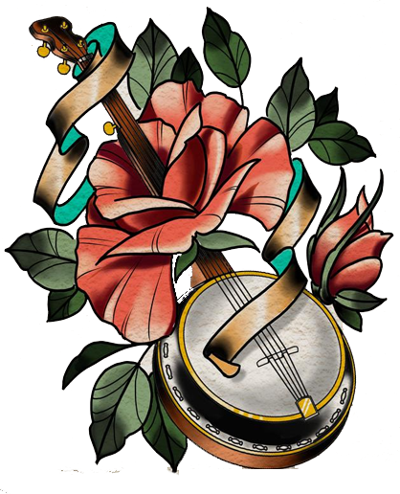
Music Lessons and Clubs
Invite musicians to teach music lessons
Low Student:Teacher Ratio
Treat like a scholarship
(applicants fill out application and write short essay.)
Taught by Adult Musicians
Taught by Teen Musicians to younger kids
Paid lessons or volunteer
Resources for your “teachers”: how-to books, youtube videos
Supervision/Anti-Bullying Policy
Playlist Parties
Create a Spotify Channel based of personal interests, books made into movies, etc
Share link on your social media, website, printed bookmarks, etc
Purchase itunes songs and burn CDs
Books with Soundtracks/playlists: create bookmarks and put in books (Scavenger Hunt)

Slide 8
Music Lessons and Clubs
Creative Writing Exercise:
Write a short story based off a song
Provide snacks!
Different types of pens and pencils.
Laptops or computers not hooked up to Internet,
or restricted to Google Docs account (all participants will need to create a gmail account then learn how to share and co-create a Google Document. Sign a non-bullying waiver)
Each teen can write own story or work in small groups:
Start with outline:
Plot, Pacing (“3 acts”), Character Development
Fill in Outline, Find “Voice” of Narrator
Editing first to final drafts
Share with other groups

Slide 9
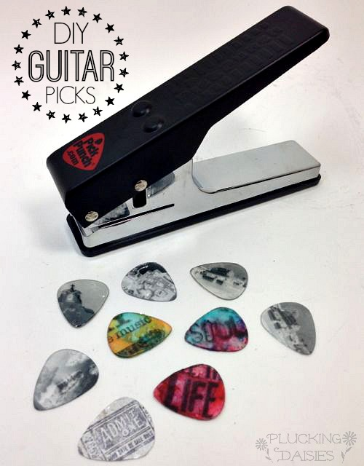
Music Minded Making
Guitar Pick Punch (~$20)
https://www.youtube.com/watch?v=lG4SiiNzYzA

Slide 10
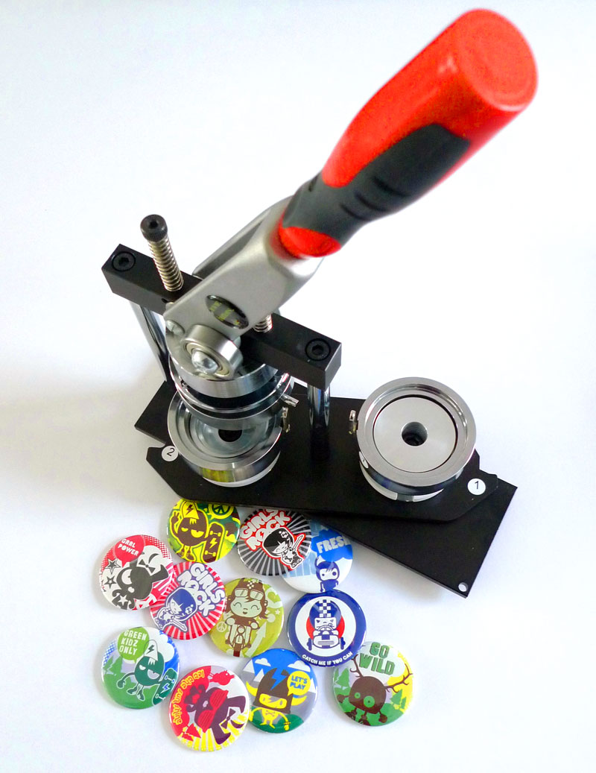
Music Minded Making
Button Maker + Old Rolling Stone issues
American Button Machines - Made in USA (~$200)

Slide 11
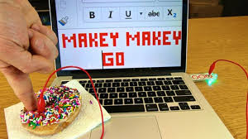
Music Minded Making
Makey Makey Music - make instruments out of everyday objects
https://www.youtube.com/watch?v=wkPt9MYqDW0
Makey Makey Go - newer product - $20!!
Makey Makey Classic works through opening and closing circuits, just like any other button. Instead of the circuit being closed underneath your keyboard, the circuit is closed through the conductive objects you connect with alligator clips like your hand or your lunch or some tinfoil. When the circuit is closed, the Makey Makey sends a command to your computer, just like when a button is pressed on a keyboard.
Makey Makey GO works through capacitance, like a button on a touchscreen. When you connect something to the Makey Makey GO, the GO senses the capacity of that object to hold electricity. When you touch the connected object, that capacity suddenly expands to include your whole body! And the Makey Makey GO senses the difference and sends a command to your computer

Slide 12
Games and Gaming
Trivia/Jeopardy
Create game yourself
Work with 2-3 of your teen volunteers to come up with Qs and As
https://jeopardylabs.com/
Guitar Hero/Dance Dance Revolution
Have an after hours event and open up entire library to teens/tweens

Slide 13
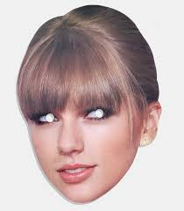
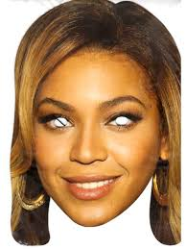
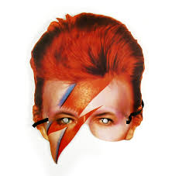
DIY Photo Booth
https://www.buzzfeed.com/morganshanahan/how-to-create-a-quick-and-easy-photo-booth-for-awesome-famil?utm_term=.eyJnMPE0J#.isQDE2Kb7
https://apracticalwedding.com/fool-proof-diy-photo-booth/
https://www.simplebooth.com/solutions/do-it-yourself-photo-booth

Slide 14
Funding and Empowerment
Teen Library Council: Let your teens organize bake sales, book sales, button sales, rummage sales under umbrella of your FOL. This level of involvement will solicit personal investment from your teens and also teach them management and teamwork skills.
Let your teens write sponsorship requests to your FOL
Help tell your teens’ story: YALSA regularly offers minigrants to programs that have already proven their success

Slide 15
Webliography
http://www.programminglibrarian.org/blog/summer-music-programs-teens-and-tweens
https://www.urbanlibraries.org/project-unknown--library-teen-music-program--innovation-102.php?page_id=45MLC 2018
Makey Makey Go: https://makeymakey.com/how-to/go/
Make Music Day: http://www.makemusicday.org/
American Button Machines: https://www.americanbuttonmachines.com/
Guitar Pick Punch: https://www.youtube.com/watch?v=lG4SiiNzYzA

Slide 16
Webliography (more)
Jeopardy Labs: https://jeopardylabs.com/
DIY Photo Booths: https://www.buzzfeed.com/morganshanahan/how-to-create-a-quick-and-easy-photo-booth-for-awesome-famil?utm_term=.eyJnMPE0J#.isQDE2Kb7
https://apracticalwedding.com/fool-proof-diy-photo-booth/
https://www.simplebooth.com/solutions/do-it-yourself-photo-booth

Slide 17
Thank you!!
Questions? Comments? Email me!
jackieapples@gmail.com
Jaclyn Lewis Anderson

