Slide 1
Youth Titles You May Have Missed
Ally Watkins
Mississippi Library Commission

Slide 2
Picture Books

Slide 3
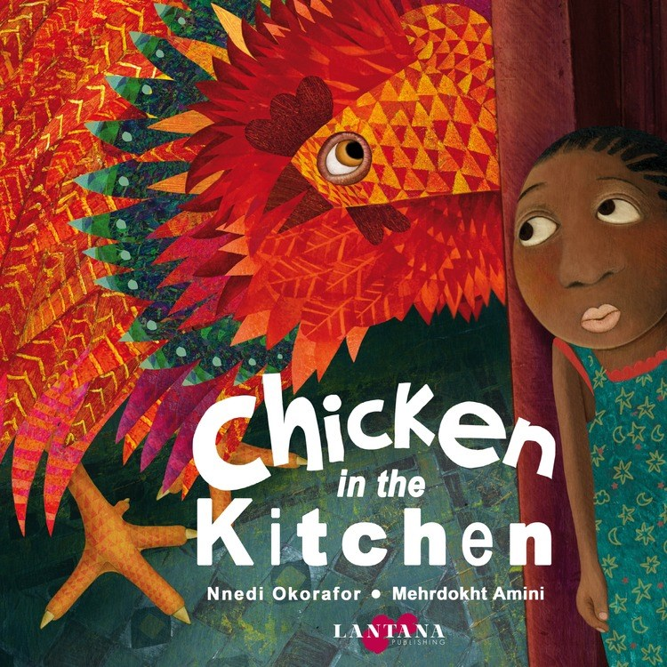
Chicken in the Kitchen by Nnedi Okorafor, illustrated by Mehrdokht Amini
Kirkus: “Okorafor leaps into the world of picture books in a most unforgettable way with this playful, fascinating tale”
School Library Journal: “Cartoon illustrations, rendered in pencil and watercolor, are filled with lots of action and detail that will bring smiles to little faces.”
Notes:
September 1
Anyaugo sees the shadow of a giant chicken passing her bedroom door. What is there to do but investigate? In this Nigerian tale, a young girl tries desperately to save the food her aunties have made for a festival the next day!

Slide 4

Dazzle Ships by Chris Barton, illustrated by Victo Ngai
Kirkus: “ An eye-catching title sure to dazzle”
Publisher’s weekly: starred review!
Notes:
September 1
During WWI, British and American ships were painted with bright colors and bold patterns in an effort to confuse enemy crafts. This fully illustrated nonfiction picture book tells about the practice and recreates the ships in gorgeous full color illustrations by first time children’s book illustrator Victo Ngai.

Slide 5

Full of Fall by April Pulley Sayre
Kirkus: “Young readers' imaginations are sure to be fired by Sayre's awe-inspiring photos and by the bite-sized science facts provided at the end of the book.”
Booklist: starred review! “Stunning illustrations illuminate this well-focused, useful presentation.”
School Library Journal: “standout for its elegance, simplicity, and gorgeous photography”
Notes:
August 29
With photo illustrations, this beautiful book explores the visual transformation that trees go through in the full. Award-winning write April Pulley Sayre has many nonfiction picture books under her belt, and this one is a beautiful addition to her body of work.

Slide 6

Hooray for Books! by Brian Won
Kirkus: “the text and illustrations probably will have the greatest appeal for children who are not yet reading independently; the simple sentences and repetitions lend themselves well to reading aloud.”
Notes:
September 12
Turtle has looked everywhere for his favorite book, but it’s nowhere to be found. As he searches, his friends share new stories with him. Is it time for Turtle to try something different? This followup to Hooray for Hat will delight your young patrons.

Slide 7

Her Right Foot by Dave Eggers, illustrated by Shawn Harris
Kirkus: “heartfelt throughout and indisputably timely”
Notes:
Sept 19
A nonfiction picture book about the Statue of Liberty—in fact, about a small part of her. It’s a story of history, of acceptance, and of meaning.

Slide 8
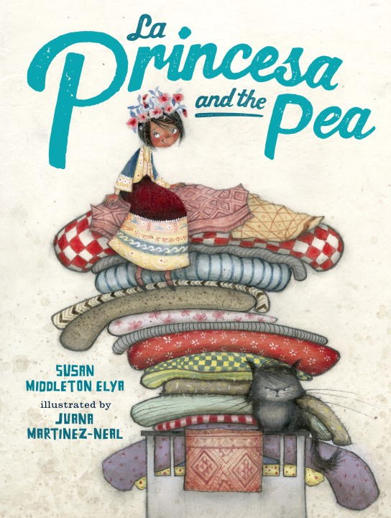
La Princesa and the Pea by Susan Middleton Elya, illustrated by Juana Martinez-Neal
School Library Journal: starred review! “This engaging read-aloud is a fresh reimagining of a classic. A must for all libraries.”
Notes:
September 5
The Princess and the Pea gets an update with this fun, bilingual retelling! When the princess arrives, the prince’s mother puts a pea under the mattress to test her suitability. But the prince isn’t taking any chances on this one so he hides some larger, lumpier items under the mattresses, just in case!

Slide 9

Muddy by Michael Mahin, illustrated by Evan Turk
Kirkus: “This poetic celebration of Muddy Waters' musical truth is lifted still higher by Turk's extraordinary art.”
School Library Journal: “ A worthy addition to biography collections, shedding light on an important figure in U.S. music history.”
Booklist: starred review! “Turk’s watercolor, ink, and collage artwork fills pages, exploding with a neon intensity— the equivalent of a dynamic guitar riff.”
Notes:
September 5.
A picture book celebration of blues Legend Muddy Waters. With blues inspired words and illustrations by award winning illustrator Evan Turk.

Slide 10
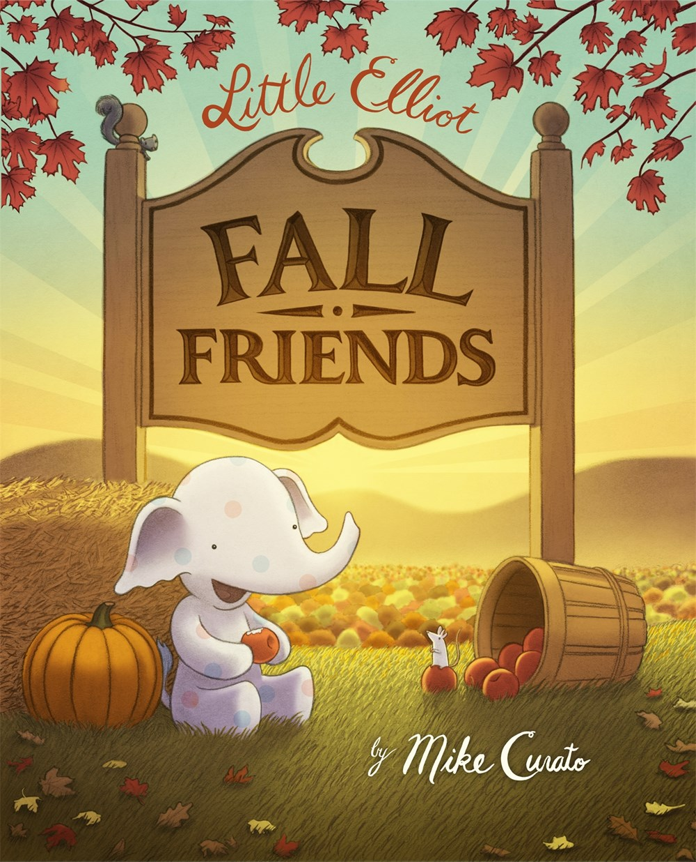
Little Elliot, Fall Friends by Mike Curato
Kirkus: “A yummy, happy resolution--perfectly delectable to the preschool crowd”
Publisher’s Weekly: starred review!
Notes:
August 29
The fourth book in the adorable Little Elliot picture book series! Little Elliot and Mouse decide to get out of the city for a vacation in the countryside, where they will enjoy the sights and smells of autumn!

Slide 11

Yo Soy Muslim by Mark Gonzalez, illustrated by Mehrdokht Amini
School Library Journal: “A lovely and lush celebration of intersectionality and identity.
Kirkus: “This book will be cherished by Muslim families seeking to boost their children's confidence and intriguing for non-Muslim families seeking to learn”
Booklist: starred review! “Using collage-style techniques and featuring bold characters, Amini’s joyful, boisterous art soars, and readers may well feel they’re flying, too. A special book that truly seems to ‘dance with the wind’ and ‘smile at the sun.’”
Notes:
August 29
Written as a letter from a father to a daughter, this book is a celebration of multicultural identities, and how families can fit into more than one. With brilliant, colorful illustrations by Amini, this is a lovely addition to a collection.

Slide 12

I Love You Like a Pig by Mac Barnett, illustrated by Greg Pizzoli
Kirkus: “This may leave readers pondering the many forms that love can take, but when is that ever a misstep?”
Booklist: “The simple line drawings, the generous white space, and the diverse faces of the children and funny animals brighten the message with the accessible illustrations. “
Notes:
September 19
Adorable new picture book from fan favorites Mac Barnett and Greg Pizzoli with simple text great for read alouds and fun, colorful illustrations!

Slide 13
Middle Grade

Slide 14
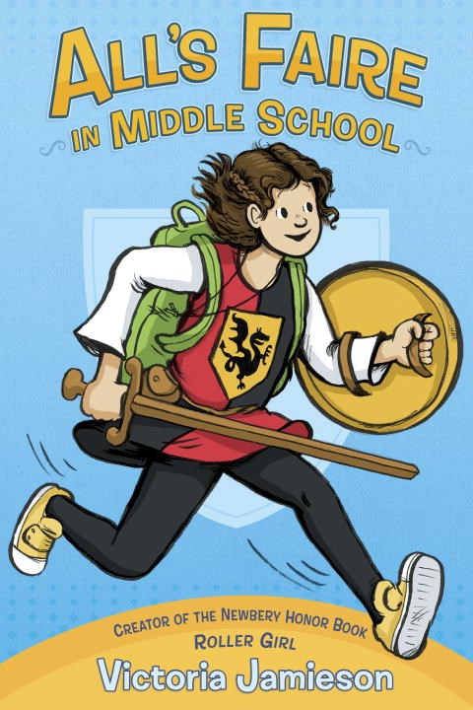
All’s Faire in Middle School by Victoria Jamieson
Publisher’s Weekly: starred review! “The fair emphasizes adventure and theater, but its unconventional performers teach Imogen about kindness, too”
Notes:
September 5
From the author/illustrator of the widely loved and Newbery Honor book Roller Girl comes a new graphic novel! Impy has grown up with two parents working at the Renaissance Faire and she’s excited that she’s old enough to train as a squire herself. But first comes a new adventure: she’s going to school for the first time after being homeschooled her whole life. Her new friends seem really nice…until they don’t. How will Impy handle her new life?

Slide 15

Best. Night. Ever. by Various Authors
Kirkus: “A fun, fresh take on a classic theme”
School Library Journal: “Tweens interested in funny friendship drama will eat this one up.”
Notes:
August 15
Rachele Alpine, Ronni Arno, Alison Cherry, Stephanie Faris, Jen Malone, Gail Nall, Dee Romito
Seven authors write seven stories about seven classmates all getting ready for the same middle school dance. 5 friends are attending the dance and the other 2 are desperate to go, what will happen that night at Lynnfield Middle School?

Slide 16
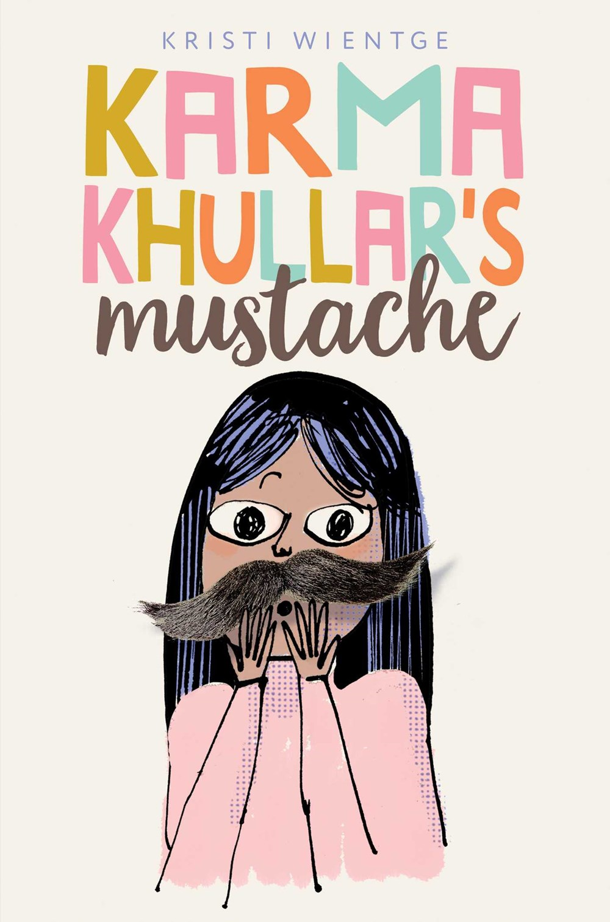
Karma Khullar’s Mustache by Kristi Wientge
Publisher’s Weekly: “Debut author Wientge neatly captures how it feels to be different, especially as an adolescent.”
Kirkus: “Readers will enjoy seeing how Karma navigates the complexities of adolescence, middle school, and the 17 hairs on her upper lip in this realistic and humorous story of new friendships and family support.”
Notes:
August 15
W-intage
Karma Khullar’s life has gotten complicated. She’s about to start middle school. She’s having friend trouble. Her mom is always at work. And she’s just realized that she has seventeen hairs on her upper lip.

Slide 17
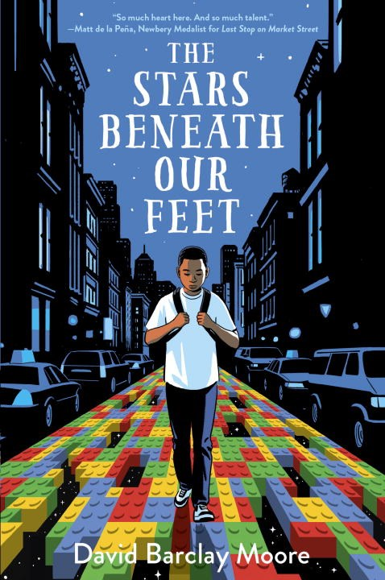
The Stars Beneath Our Feet by David Barclay Moore
Publisher’s Weekly: starred review! “Debut author Moore delivers a realistic and at times brutal portrait of life for young people of color who are living on the edge of poverty. At the same time, Moore infuses the story with hope and aspiration, giving Lolly the chance to find salvation through creativity”
Kirkus: “These characters are vibrantly alive, reconstituting the realness that is needed to bring diverse, complicated stories to the forefront of our shelves”
Notes:
September 19
Lolly and his mom aren’t up to celebrating Christmas, not after the death of Lolly’s older brother. But when Lolly is gifted two giant bags of Legos, things change. He’s under pressure from everyone, and most especially to join a gang, like his brother did, but building legos at the community center is offering him an escape and might just be his way forward.

Slide 18
Young Adult

Slide 19
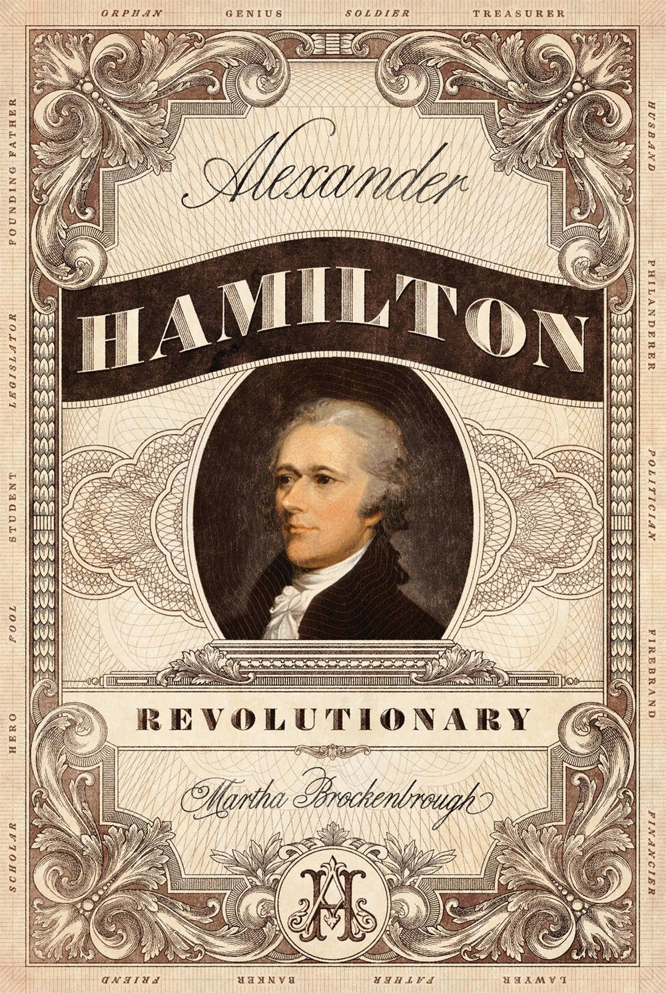
Alexander Hamilton, Revolutionary by Martha Brockenbrough
School Library Journal: “A highly enjoyable, well-researched biography of Alexander Hamilton that both applauds his significant accomplishments and highlights his flaws”
Publisher’s Weekly: “Brockenbrough's ambitious and impressively researched project gives equal weight to Alexander Hamilton's personal and professional lives and to the history of the founding and early years of the United States.”
Notes:
September 5
The Hamilton buzz has come to YA with a new biography by Martha Brockenbrough. An in-depth biography aimed at teens informed by Hamilton’s own writings, containing both archival artwork and new illustrations, your teens that love the musical but maybe aren’t willing to read an 800 page adult biography will be sure to devour this one!

Slide 20

The Arsonist by Stephanie Oakes
School Library Journal: “A strong choice for suspense and thriller collections”
Booklist: “dynamic characters, thoughtful writing, and a decades-spanning mystery, this will appeal to readers looking for something off the beaten path”
Notes:
August 22
Two very unusual teens are brought together and determined to solve the murder of a third—an east german resistance fighter who died in 1989 at the age of 17. Can Molly and Pepper push through everything that’s going on in their lives to figure out what happened to Ava?

Slide 21
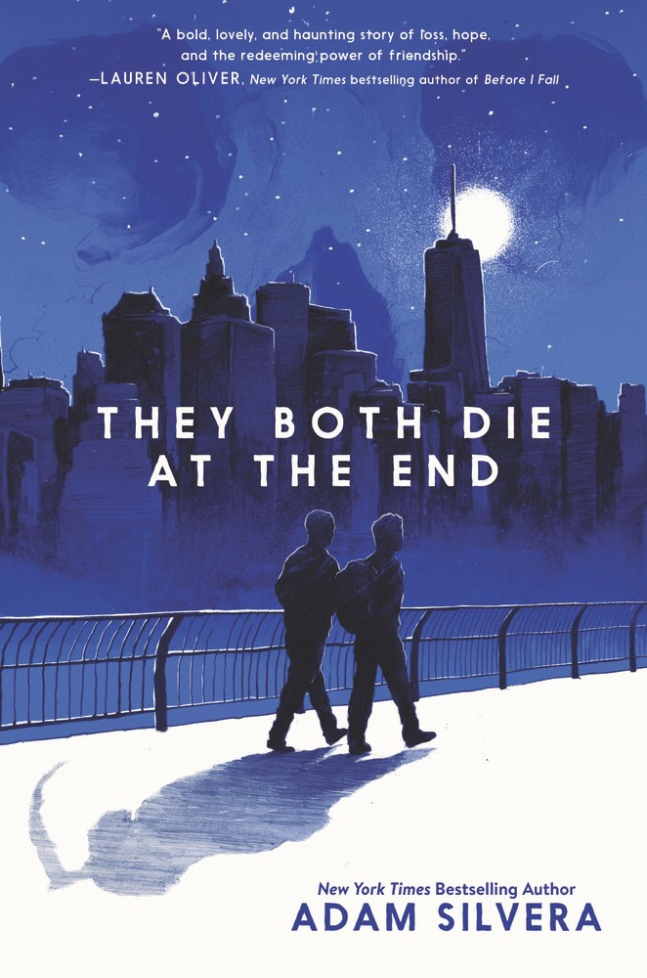
They Both Die at the End by Adam Silvera
Booklist: starred review! “Silvera does a remarkable job of inviting empathy for his irresistible coprotagonists”
Kirkus: “Engrossing, contemplative, and as heart-wrenching as the title promises”
Publisher’s Weekly: starred review!
Notes:
September 5
In this world, everyone gets a phone call the night before they die. Mateo and Rufus are both fated to die within 24 hours. They’re total strangers, but they’re both game to meet a new friend on their Death Day. Luckily, there’s an app for that, and the two boys decide to have an adventure and try live their lives to the fullest—for the one day before they end.

Slide 22

Disappeared by Francisco X. Stork
Kirkus: “A tense thriller elevated by Stork's nuanced writing and empathy for every character, including the villains—superb.”
Publisher’s Weekly: “Stork crafts a narrative that is both riveting and eye-opening.”
Notes:
September 26
Siblings Sara and Emiliano are caught up in “the web”—the group of criminals that terrorize Juarez, where they live. Sara’s best friend has disappeared and it’s connected to the web. Emiliano has been offered a job in the web. But when circumstances start to close in on them, they must make hard choices and that may mean the only way out is through the desert to the United states.

Slide 23
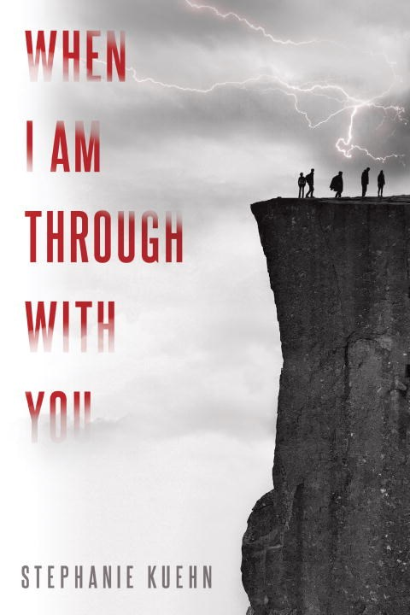
When I Am Through With You by Stephanie Kuehn
School Library Journal: “A tense survival story and a grim exploration of pain, guilt, and choice”
Booklist: “This chilling, twisty tale will leave readers grappling with its uncomfortable ending”
Kirkus: “Full of secrets and plot twists, Kuehn's latest is a satisfying, sophisticated study in complicated relationships”
Publisher’s Weekly: “a harrowing story that succeeds in keeping readers off-balance from start to finish”
Notes:
August 1
Ben Gibson isn’t a liar. He’s going to tell you the truth about that school camping trip. About who lived and who died. About who killed and who didn’t. But he’s going to tell you the way he wants to tell you, because after what happened on that mountain, all he has is time.

Slide 24
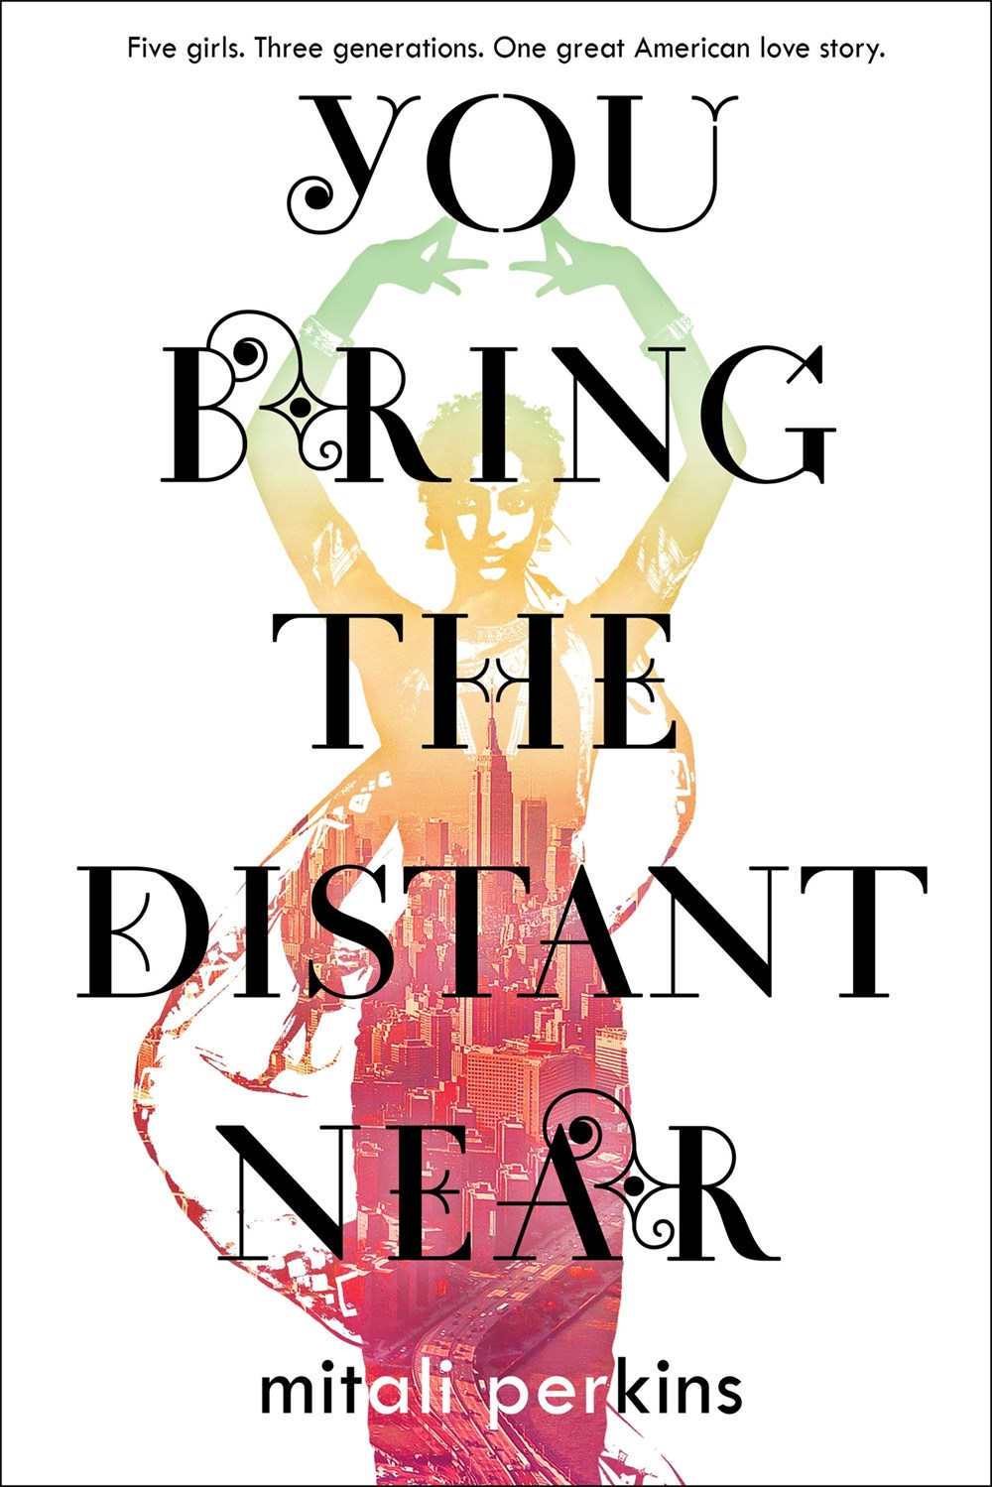
You Bring the Distant Near by Mitali Perkins
Booklist: starred review! “Full of sisterhood, diversity, and complex, strong women, this book will speak to readers as they will undoubtedly find a kindred spirit in at least one of the Das women”
Publisher’s Weekly: starred review! “Perkins’s vibrantly written exploration of a family in transition is saturated with romance, humor, and meaningful reflections on patriotism, blended cultures, and carving one’s own path.”
Notes:
September 12
With four starred reviews, this story has been extremely well-received by review sources. A sweeping family story of five women told in alternating voices across three generations. Tells the story of the immigrant experience from the perspective of one Indian American family

Slide 25
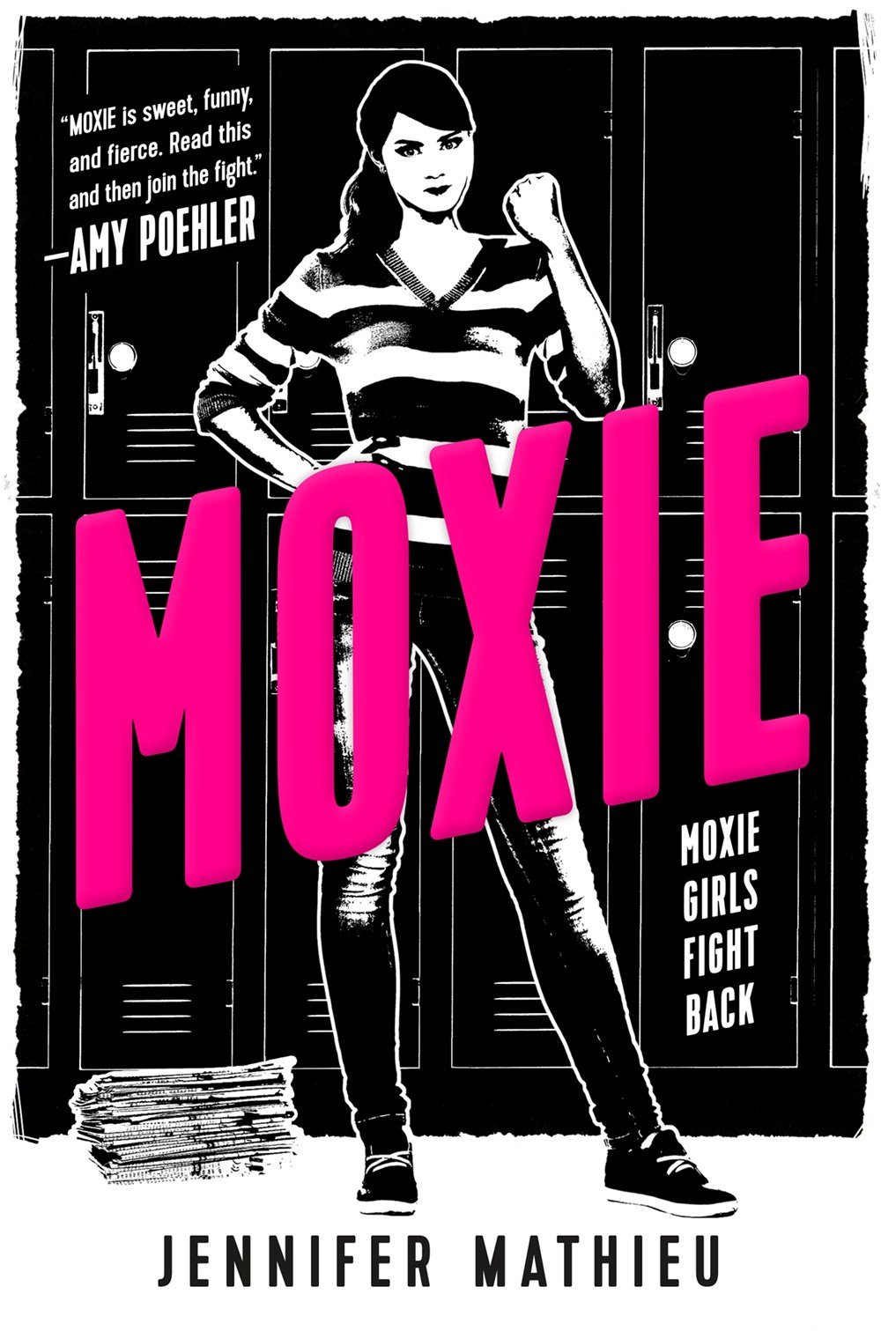
Moxie by Jennifer Mathieu
School Library Journal: starred review! “Highly recommended for all teens, but especially those who would enjoy realistic coming-of-age fiction with female empowerment.”
Notes:
September 19
Viv Carter is fed up with her school, with the football players getting away with anything, with the dress code, and with gross comments from guys in the hall. Drawing from her mother’s 90s riot Grrrl roots, she creates a feminist zine and distributes it anonymously to her classmates. What happens next is nothing short of a girl revolution.

Slide 26
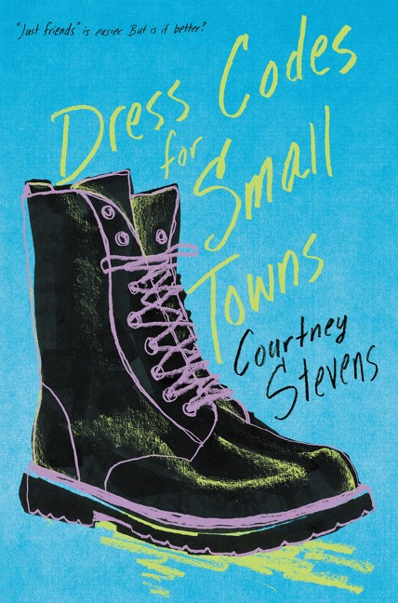
Dress Codes for Small Towns by Courtney Stevens
Booklist: starred review! “This is a beautifully written, quiet, and nuanced exploration of human connection, self-discovery, and living to the fullest no matter what others might think.”
Kirkus: “A spirited, timeless tale of teen self-discovery in those tense, formative high school moments, captured with grace, lyricism, and insight.”
School Library Journal: “This is The Perks of Being a Wallflower without the angst, for a new generation. A good choice for every collection.”
Notes:
August 22
Tomboy Preacher’s Kid Billie has always struggled to fit the mold. She’d rather hang out with her solid group of friends. But when she starts to develop feelings that even she doesn’t understand, she starts to wonder if she’ll ever fit into any kind of box. An exploration of teenage identity, and the grey areas of love, friendship, and gender, teens that are a little outside the box like Billie will love this one.

Slide 27
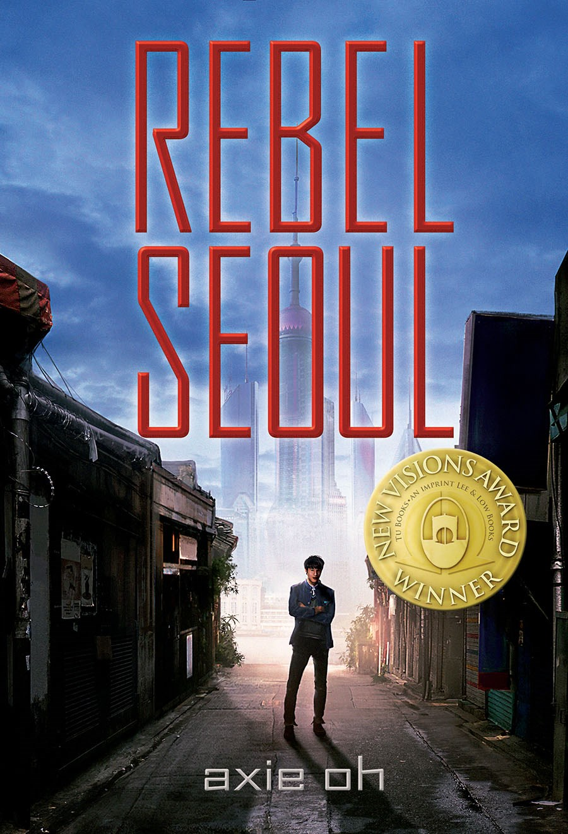
Rebel Seoul by Axie Oh
New Visions Award Winner
Kirkus, starred review! “Oh blends futuristic tech, authentic Korean culture, and romance in this complex, utterly engrossing, and wholly fresh story”
Notes:
September 14
A science fiction debut from Axie Oh, this book imagines a post-war world where the East Pacific is in ruins. Aspiring young pilot seeks military glory in hopes of shaking of the legacy of the rebel father who abandoned him. He gets his chance with a special mission to observe and report on experimental supersoldier Tera, but as his partnership with Tera grows stronger and he uncovers more and more disturbing military secrets he must face the possibility that his father was right all along. Is he a soldier or a rebel?

Slide 28
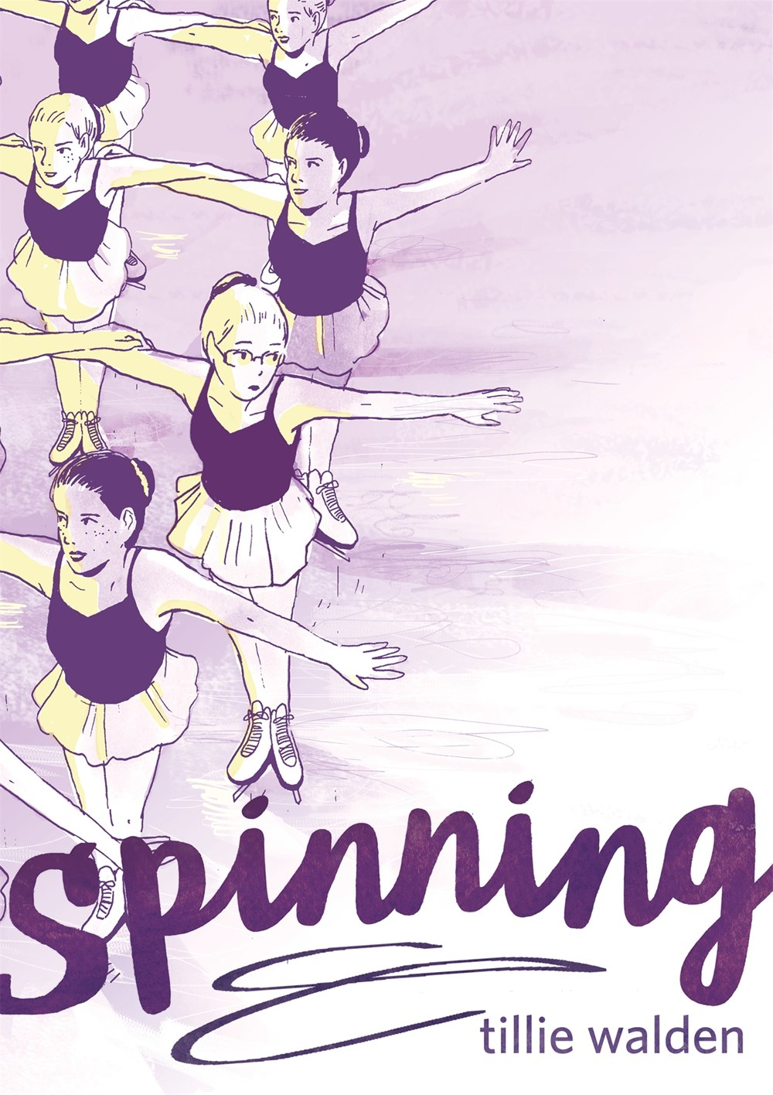
Spinning by Tillie Walden
Publisher’s Weekly: starred review! “A haunting and resonant coming-of-age story.”
Booklist: starred review! “A stirring, gorgeously illustrated story of finding the strength to follow one’s own path. “
Notes:
September 12
A teen graphic memoir. For ten years, figure skating was Tillie Walden’s entire life—practices for hours a day and on weekends, competitions, and more. But as she switched schools, got into art, and fell in love for the first time, she began to question—was this what she really wanted to do? A stirring memoir of a young girl discovering what she truly wants and finding her voice.

Slide 29
Ally Watkins
awatkins@mlc.lib.ms.us

