Slide 1
Privacy and Your Patrons
why it’s important and how to protect it

Slide 2
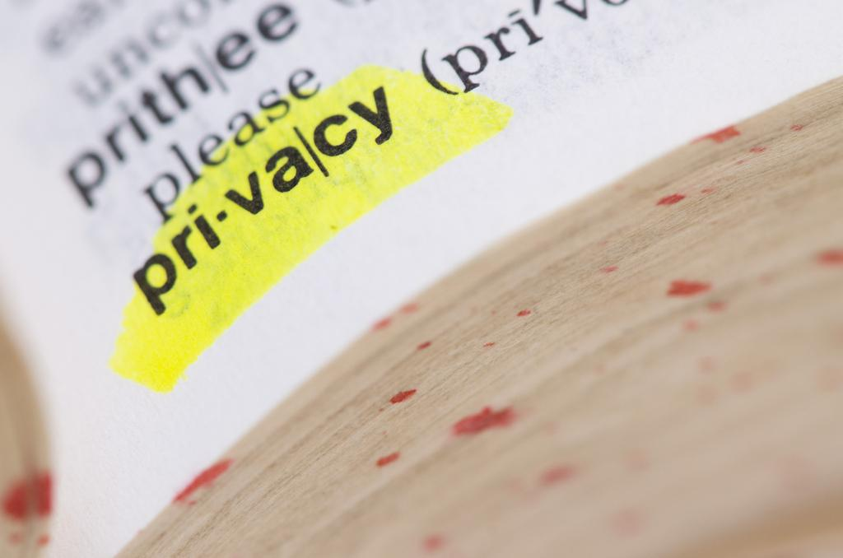
Privacy defined
The state or condition of being alone, undisturbed, or free from public attention, as a matter of choice or right; seclusion; freedom from interference or intrusion.
Absence or avoidance of publicity or display; secrecy, concealment, discretion; protection from public knowledge or availability.
privacy, n." OED Online. Oxford University Press, September 2016. Web. 5 December 2016.

Slide 3
U.S. Law
US Courts have established that receiving information through a publicly funded library is a right protected under the First Amendment.
-Board of Education v. Pico, 457 U.S. 853 (1982)
-Kreimer v. Burea of Police for Town of Morristown, 958 F.2d 1242 (3d Cir. 1992)
-Reno v. American Civil Liberties Union, 117 S.Ct. 2329, 138 L.Ed.2d 874 (1997)
The Fourth Amendment guarantees “the right of the people to be secure in their persons, houses, papers, and effects, against unreasonable search and seizures”
The Fifth Amendment guarantees against self-incrimination.
“No one shall be subjected to arbitrary interference with his privacy, family, home
or correspondence, nor to attacks upon his honour and reputation. Everyone has
the right to protection of the law against such interference or attacks.”
-Article 12, Universal Declaration of Human Rights
http://www.un.org/en/universal-declaration-human-rights/

Slide 4
Library Bill of Rights
The American Library Association affirms that all libraries are forums for information and ideas, and that the following basic policies should guide their services.
I. Books and other library resources should be provided for the interest, information, and enlightenment of all people of the community the library serves. Materials should not be excluded because of the origin, background, or views of those contributing to their creation.
II. Libraries should provide materials and information presenting all points of view on current and historical issues. Materials should not be proscribed or removed because of partisan or doctrinal disapproval.
III. Libraries should challenge censorship in the fulfillment of their responsibility to provide information and enlightenment.
IV. Libraries should cooperate with all persons and groups concerned with resisting abridgment of free expression and free access to ideas.
V. A person’s right to use a library should not be denied or abridged because of origin, age, background, or views.
VI. Libraries which make exhibit spaces and meeting rooms available to the public they serve should make such facilities available on an equitable basis, regardless of the beliefs or affiliations of individuals or groups requesting their use.
Adopted June 19, 1939, by the ALA Council; amended October 14, 1944; June 18, 1948; February 2, 1961; June 27, 1967; January 23, 1980; inclusion of “age” reaffirmed January 23, 1996.

Slide 5
ALA Code of Ethics
We provide the highest level of service to all library users through appropriate and usefully organized resources; equitable service policies; equitable access; and accurate, unbiased, and courteous responses to all requests.
We uphold the principles of intellectual freedom and resist all efforts to censor library resources.
We protect each library user's right to privacy and confidentiality with respect to information sought or received and resources consulted, borrowed, acquired or transmitted.
We respect intellectual property rights and advocate balance between the interests of information users and rights holders.
We treat co-workers and other colleagues with respect, fairness, and good faith, and advocate conditions of employment that safeguard the rights and welfare of all employees of our institutions.
We do not advance private interests at the expense of library users, colleagues, or our employing institutions.
We distinguish between our personal convictions and professional duties and do not allow our personal beliefs to interfere with fair representation of the aims of our institutions or the provision of access to their information resources.
We strive for excellence in the profession by maintaining and enhancing our own knowledge and skills, by encouraging the professional development of co-workers, and by fostering the aspirations of potential members of the profession.

Slide 6
What does the MS Code say?
TITLE 39. LIBRARIES, ARTS, ARCHIVES AND HISTORY
CHAPTER 3. LIBRARIES AND LIBRARY COMMISSION
Article 9. MISSISSIPPI STATEWIDE LIBRARY DEVELOPMENT SYSTEM ACT OF 1988
§ 39-3-365. Confidentiality of library user records
Records maintained by any library funded in whole or in part by public funds, which contain information relating to the identity of a library user, relative to the user's use of books or other materials at the library, shall be confidential. Such records may only be released with the express written permission of the respective library user or as the result of a court order.
§ 39-3-367. Release and use of aggregate statistics
Aggregate statistics shown from registration and circulation records, with all personal identification removed, may be released or used by a library for research, planning and reporting purposes.
§ 39-3-369. Use of records for purpose of collecting overdue materials and fines
No provision of this article shall be construed to prohibit any library, or any business operating jointly with a library, from disclosing information for the purpose of collecting overdue books, documents, films or other items or materials owned or otherwise belonging to such library. No provision of this act shall be construed to prohibit or hinder any such library or business office from collecting fines on such overdue books, documents, films or other items or materials.

Slide 7
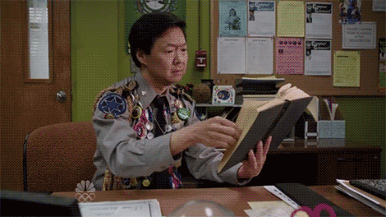
Why is it important in the library?
Privacy is essential to a patron’s right to free speech, free thought, and free association. It enables the patron to access, select, and use information without the fear of judgement, surveillance, punishment, or ostracism.
When a patron recognizes or feels that their privacy is not being protected, true freedom of inquiry no longer exists. A lack of privacy has a “chilling” effect on a patron’s choices.
In short, privacy protects a patron’s freedom to read.

Slide 8
“For if we are observed in all matters, we are constantly under threat of correction, judgment, criticism, even plagiarism of our own uniqueness. We become children, fettered under watchful eyes, constantly fearful that—either now or in the uncertain future—patterns we leave behind will be brought back to implicate us, by whatever authority has now become focused upon our once-private and innocent acts. We lose our individuality, because everything we do is observable and recordable.”
-Bruce Schneier
Schneier, Bruce. “The Eternal Value of Privacy” Schneier on Security. 18 May 2006. https://www.schneier.com/essays/archives/2006/05/the_eternal_value_of.html

Slide 9
What is personally identifiable information?
Personally identifiable information - any information that can link reading materials, questions, tastes, research, etc. to a specific individual. This kind of information can build a picture of a person’s tastes or interests.
This kind of information is collected in a number of small ways in libraries. Take a look at the places where you collect and/or dispense this kind of information and determine if collecting this information is necessary for the operation of the library.
-Computer log books
-Holds shelves
-Voicemail messages
-Reference request records

Slide 10
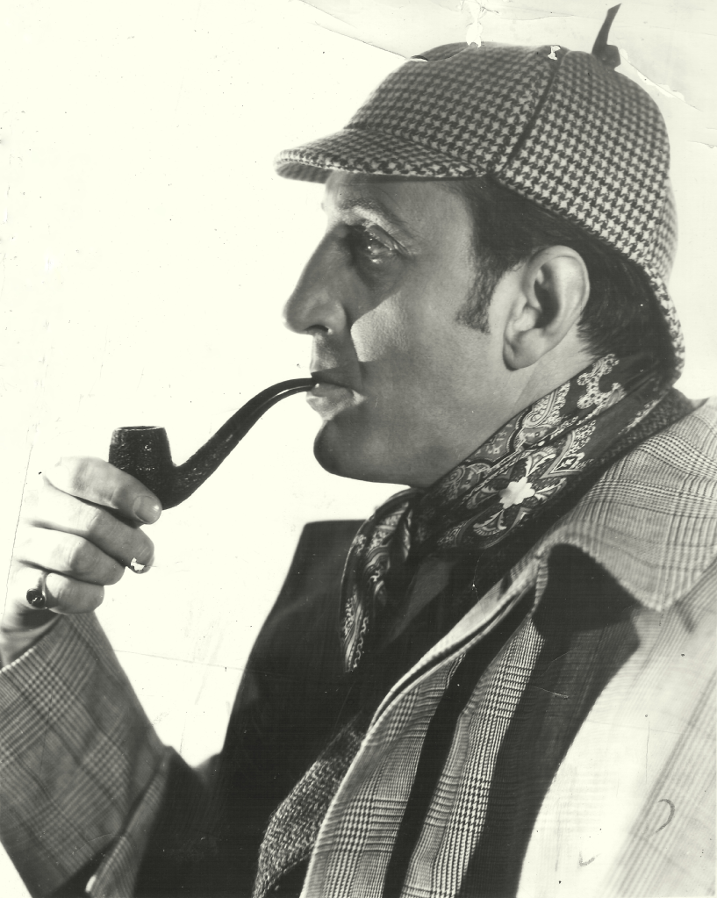
Conduct a privacy audit
This is a good first step to take when creating or updating a privacy policy for your library.
A privacy audit examines how a library collects, stores, uses, shares, and destroys information about patrons and employees.
Begin by reviewing libraries current policies and practices on handling personal information.
Mapping how information flows through a system is a good way to uncover flaws in security.
For more info. On conducting a privacy audit in your library visit: http://www.ala.org/advocacy/privacyconfidentiality/toolkitsprivacy/Developing-or-Revising-a-Library-Privacy-Policy#privacyaudit

Slide 11
Have a policy in place
A privacy policy reflects a library’s commitment to protect personally identifiable information (PII).
Tells how information is used and explains when PII might be disclosed or shared.
The policy should state how the measures outlined in it will be enforced.
It’s a good idea to consult an attorney when preparing one to ensure the policy is in compliance with state and federal laws.
Make your policy publicly available to your users

Slide 12
Privacy Policy Examples
New York Public Library - https://www.nypl.org/help/about-nypl/legal-notices/privacy-policy
Boston Public Library - http://www.bpl.org/general/policies/privacy.htm
State Library of Iowa - http://www.statelibraryofiowa.org/ld/k-p/Policies/confidentiality
California State Library - http://www.library.ca.gov/privacy.html

Slide 13
Requests for information from law enforcement
Designate a person or persons at the library who is responsible for fielding these requests. (Library director or library attorney if you have one)
Let staff know that they should refer all requests from law enforcement to the library employee authorized to handle such requests.
In most circumstances, law enforcement cannot compel you hand over records without some form of “judicial process” - subpoena, search warrant, or other legal court order.
If an officer insists that it is an emergency situation/”exigent circumstance” and that they have probable cause for seizure of records, then they might take custody of records despite your objections. Do not interfere, but do indicate that you did not grant permission. This is so the library is not held responsible for any legal risks that might come with proceeding without a warrant.

Slide 14
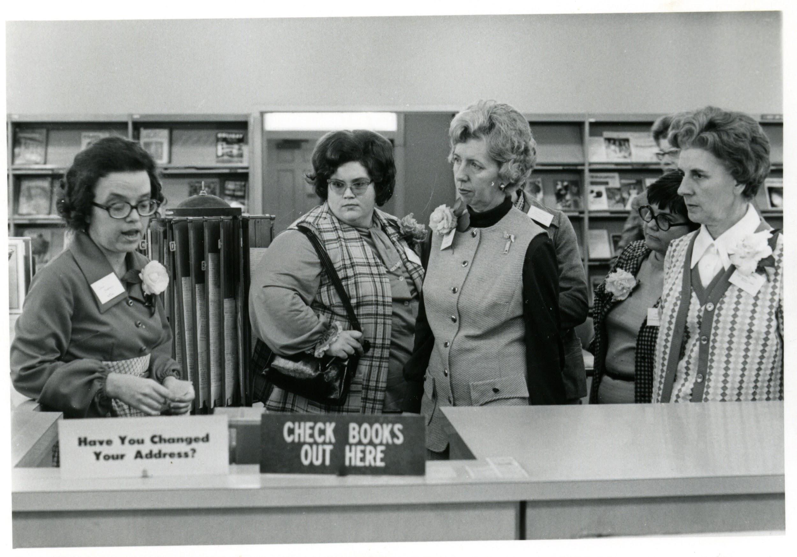
Educate your staff
Be sure all staff, paid and unpaid, are aware of your privacy policies and how to be in compliance with them.
Conduct staff training on how to handle sensitive situations.
All staff have the responsibility to create and maintain an environment that is protective of the privacy of all users.

Slide 15
Inform your patrons
Patrons have a right to know what information the library collects and what that information is used for.
It’s always good to hear someone is looking out for you. Let them know you value their privacy.
Judgement free zone!

Slide 16
Practical ways you can help your patrons protect their own privacy.
Teach them how to create secure passwords for all of their online accounts.
Be aware of scams and let patrons know about them (ex. The prince in Zanzibar who wants to wire you $1million)
Conduct programming centered around digital privacy and safety
Create quick tech guides with information on things like password management, safe browsing, etc.

Slide 17
What are some changes you can make to protect your patrons?
At MLC, we recently changed the way we record and keep track of reference requests.

Slide 18
More resources
ALA Privacy Toolkit - ala.org/advocacy/privacyconfidentiality/toolkitsprivacy/privacy
Privacy Rights Clearing House - privacyrights.org
ALA Office for Intellectual Freedom- ala.org/offices/oif
Magi, Trina. (2015). Intellectual Freedom Manual (9th ed.). Chicago: American Library Association.
Macrina, Allison (2016) Protecting Patron Privacy. Library Journal. http://lj.libraryjournal.com/2016/07/digital-resources/protecting-patron-privacy/#_

Slide 19
Have more questions? Contact me!
Ally Mellon | Information Services Director
Mississippi Library Commission
3881 Eastwood Drive
Jackson, MS 39211
601.432.4117
amellon@mlc.lib.ms.us

