Slide 1
Digital Resources for Job Seekers MLC-Extension Tech Academy May 4th, 2016

Slide 2
New Reality
94% of recruiters use or plan to use social media for recruiting
30% Google searches or 300 million per month are employment related
49% improvement in candidate quality recruiting through social media
90%+ of large companies use applicant tracking system (ATS)
Source: Capterra Blog
Source: Wall Street Journal

Slide 3
What’s out there?
Improving your skills
Resume writing
Interviewing
Job searching

Slide 4
Improving your skills …
EMCC digital literacy career enhancement
techoutreach.msucares.com/emcc

Slide 5
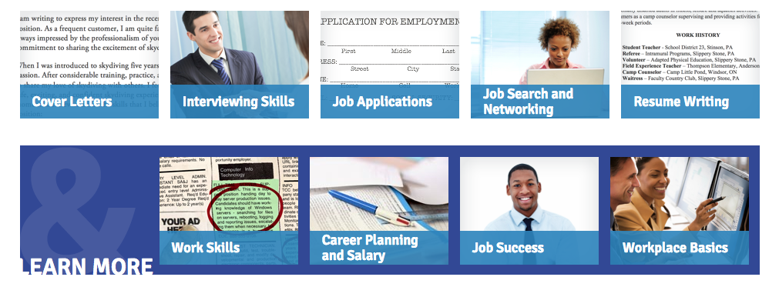
Improving your skills …
Goodwill Community Foundation
www.gcflearnfree.org/jobsearch

Slide 6
Improving your skills …
Browse resources, find educator tools, learn the basics, learn job skills
www.digitalliteracy.gov

Slide 7
Improving your skills …
Take advantage of Massive Open Online Courses (MOOC)
www.coursera.org
www.edX.org
www.udacity.com

Slide 8
Searching for jobs
MS Dept. of Employment Security
Major Job Boards
Specialty Job Boards
Company Specific Job Boards
Social Networks
Create accurate profile!

Slide 9
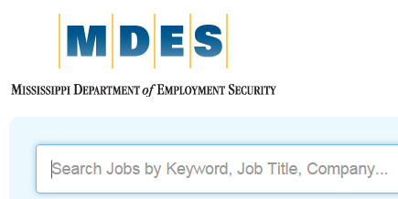
Mississippi WINGS
Mississippi Department of Employment Security (MDES)
Web portal & mobile app (MS Works)
wings.mdes.ms.gov

Slide 10
Major Job Boards
www.careerbuilder.com
www.monster.com
www.indeed.com
www.usajobs.com
www.jobhuntersbible.com
www.jobsearch.about.com

Slide 11
Specialty Job Boards
www.rigzone.com
www.mepjobs.com
www.healthjobsusa.com
www.flexjobs.com
www.upwork.com

Slide 12
Company Specific Job Boards
www.careers.lowes.com
www.careers.homedepot.com
www.dollargeneral.com
careers.walmart.com
Regional employers

Slide 13
Social Networks
Business oriented social networking site
260+ million members (including companies)
www.linkedin.com

Slide 14
Other Resources
Occupational Outlook Handbook
Job growth
Educational requirements
Salary ranges
www.bls.gov/ooh

