Slide 1

Cloud Applications
MLC-Extension Tech Academy
March 2, 2016

Slide 2
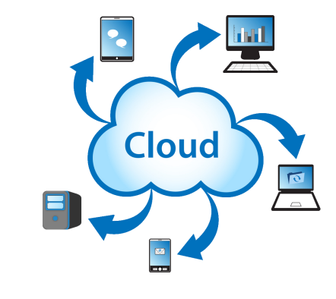
Today’s workshop
Cloud fundamentals
Mailchimp
Dropbox
OneDrive

Slide 3
Why the “Cloud” is possible
Capacity (storage)
Capacity (processing)
Internet speeds

Slide 4
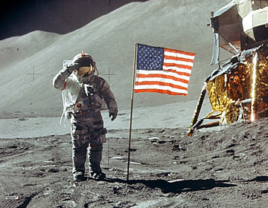
Storage Sizes
1 Kilobyte (KB) = 1,024 Bytes
1 Megabyte (MB) = 1,024 Kilobytes
1 Gigabyte (GB) = 1,024 Megabytes
1 Terabyte (TB) = 1,024 Gigabytes
64 KB

Slide 5
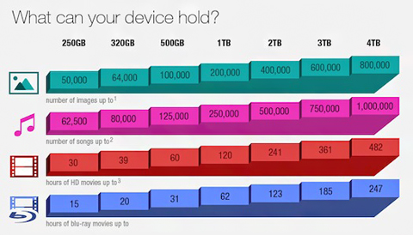
Storage Sizes
Source: newegg.com
Notes:
¹Photos based on a 10-Megapixel camera producing images 5MB in size
²Songs based on average length of 4 minutes, 4MB size
³HD video based on 720p or 1080i video
⁴Blu-ray HD Movie was calculated at 16.2GB per hour recording rate

Slide 6

Storage Sizes
In 1981 a 10 megabyte hard drive cost nearly $3,000. To store 1 gigabyte (1,024 megabytes) would cost $300,000
Cloud services offer 1 gigabyte for $0.99 per month

Slide 7
Processing capacity
Million of instructions per second (MIPS)
University super-computer in late 1980’s ran at 7 MIPS
Intel Core 2 chip (used in desktops and laptops) unveiled in 2008 ran at 59,000 MIPS

Slide 8

Did You Know?
Smartphone in your pocket has more number-crunching capacity that ALL of NASA in 1969?

Slide 9
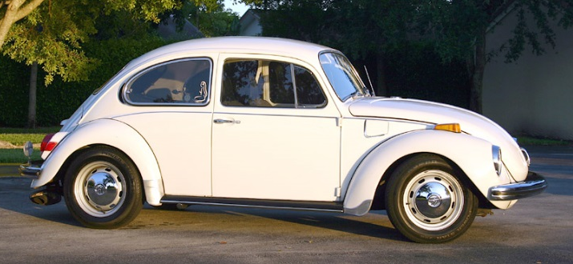
Did You Know?
If a 1971 VW beetle improved as did computer chips …
  Would reach 300,000 mph
  Fuel economy of 2 million mpg
  Would cost 4 cents
Source: Thomas Friedman, New York Times

Slide 10

Internet Speeds

Slide 11
What is the Cloud?
Internet = cloud
Web-based service
Increases productivity
Available anywhere*
Productivity & Collaboration
Storage/Backup

Slide 12

In the past …

Slide 13
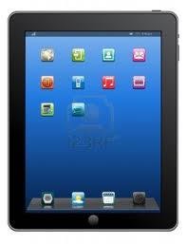
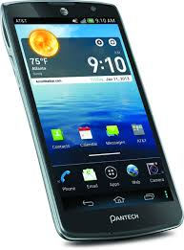
Today …
Example

Slide 14





Cloud Fundamentals
Access anywhere*
Link devices to account
Sync files
Upload/download files; create online
Sharing controls

Slide 15

Cloud Services - Examples
Storage/Backup
  Mozy
  Dropbox
  Carbonite
Storage Collaboration
  Evernote
  Google Drive
  OneDrive / Office 365
  Prezi
Blogging, Email marketing, other …

Slide 16

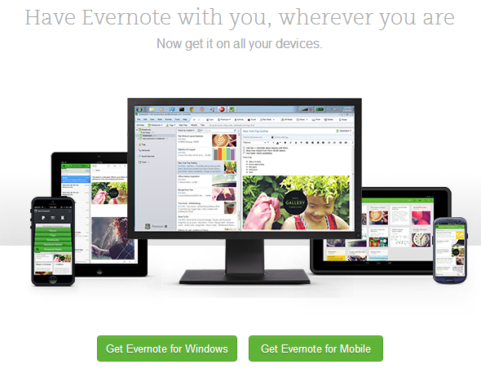
Evernote
Storage & collaboration application
Creates and manages notes
Requires a valid email address
Open account at www.evernote.com
Basic, premium, and business accounts
Multiple versions

Slide 17

Evernote Content
Web interface
Note types
Managing notes
Sharing notes
Reminders
Download & install app

Slide 18
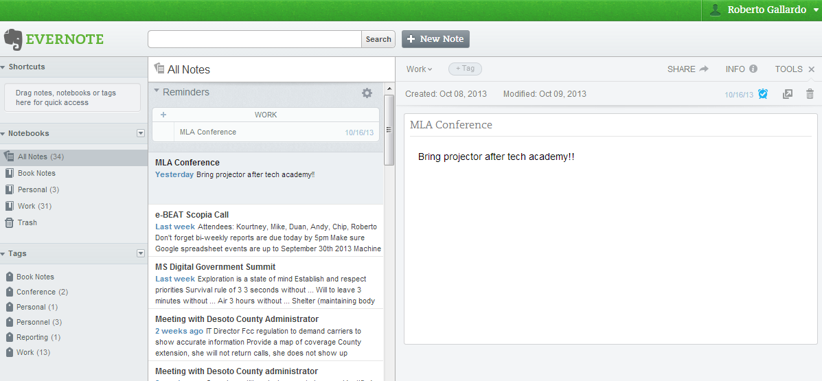
Web Interface

Slide 19
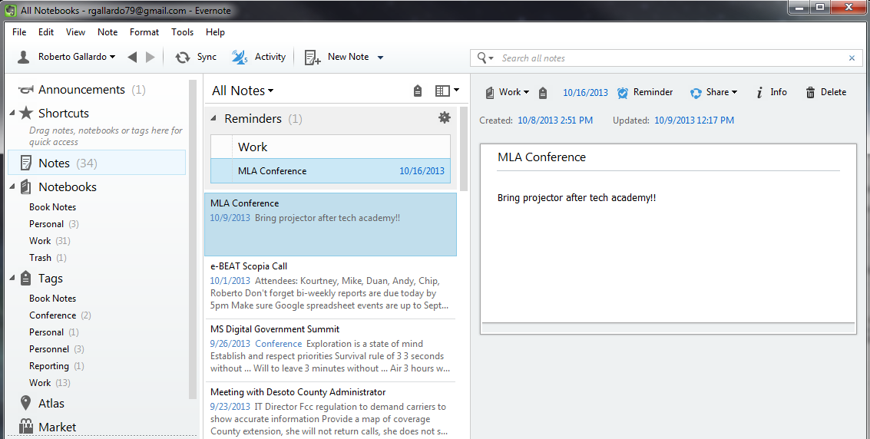
Desktop Software

Slide 20
Note types
Defined by version used (PC; Web; Mobile)
Traditional note (PC, Mobile)
Ink note (PC)
Audio note (PC, Mobile)
Picture note (Mobile)
Attachment note (Mobile)
Webcam note (PC)

Slide 21
Managing notes
Notebooks
Tags
Reminders
Links to other notes
Sharing
  Notes or Notebooks
Apps
  Web Clipper

Slide 22

Keep in mind …
Web interface & desktop software; use desktop software preferably to manage notes
Limited space use per month (60 MB) with free account
Multiple users not allowed (unless note is shared)

Slide 23
Hands-on exercise
Open account
Download/install software
Register account with computer
Create note; insert link to another note
Add tag; add to specific notebook
Share note
Delink (sign-out) account from computer

Slide 24

MailChimp
www.mailchimp.com
Sign up for free account
Verify e-mail address
Create account
Send 12,000 e-mails to 2,000 subscribers or less a year

Slide 25
Email Marketing - Advantages
Collect e-mail addresses
Organize e-mail addresses into lists
Target specific groups
Schedule e-mails in advance
Attach images, links, or other digital resources
Know the success of your e-mail

Slide 26
MailChimp – Key Elements
Campaigns: lets you design and send emails
Templates: create and edit reusable email templates
Lists: add subscribers; group them by list or by groups within a larger list

Slide 27
Generate a list
What groups do you work with?
    4-H
    Master Gardeners
    MHV
    Forestry Association
    Cattleman’s Association
    Book Club
(1) create a list for each group to send specific e-mails or (2) create one list and divide into groups

Slide 28
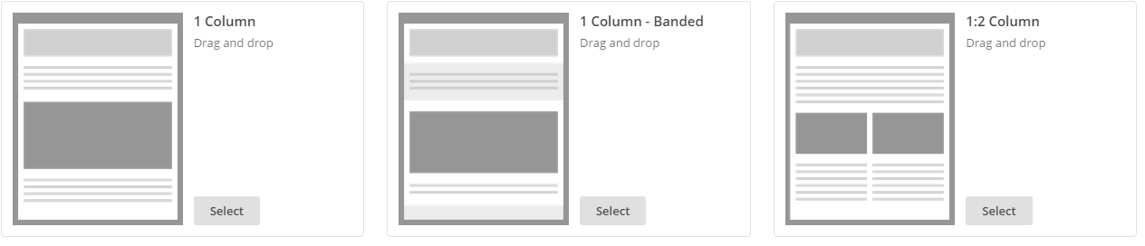
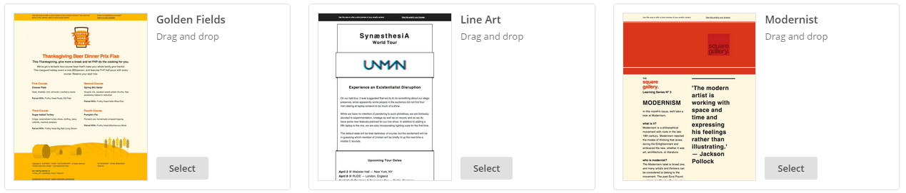
Design a template!
Basic
Themes
Code your own

Slide 29
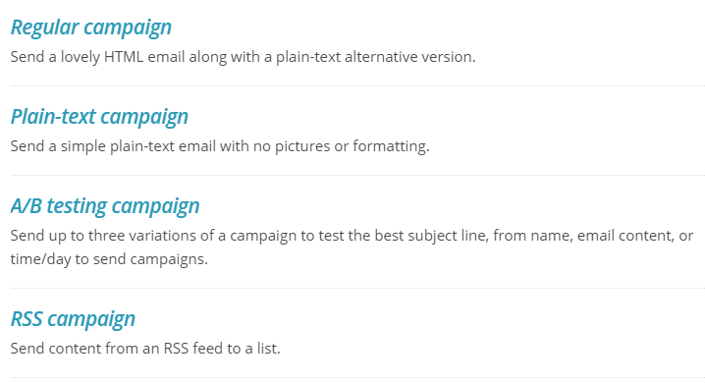
Create a campaign

Slide 30
Ag Comm Requirements
Choose one of the following titles for the organization name:
  MSU Extension, Choctaw County Office
  Choctaw County Extension Office
Add the MSU Extension logo to e-mails
  Access the Intranet
  Resources > Marketing > Logos & Graphics
  Download appropriate logo

Slide 31
Hands-on exercise
Create list
  Name of list
  Default ‘from’ email
  Default ‘from’ name
Import contacts or add manually
Select template
Populate content
Select campaign type
Send campaign (email!)

Slide 32

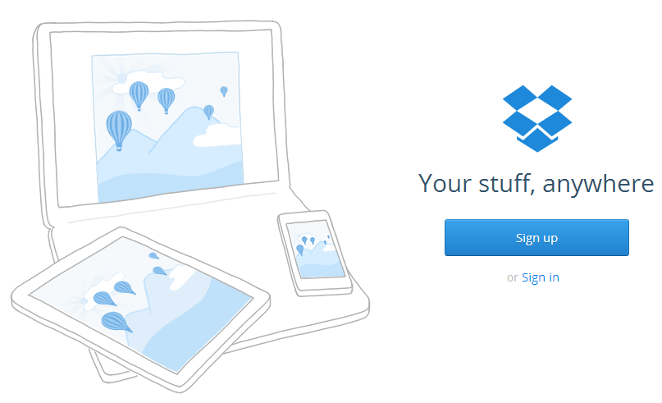
Dropbox
Store & share documents (Office, PDF, Pictures, etc.)
Requires valid email address
Open account at www.dropbox.com
Free (2GB), Pro, and Business accounts
Web and computer/device interface

Slide 33
Dropbox Content
Web interface
Upload/Download files
Sharing/Unsharing files
Editing Microsoft Office files
Download & install desktop app
Manage linked devices (web)
Unlink device (app)

Slide 34
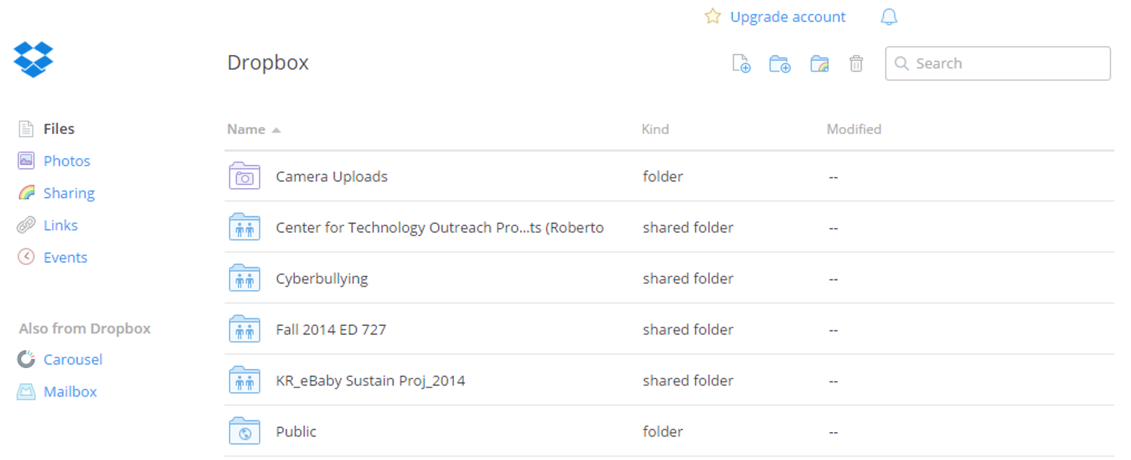
Web Interface

Slide 35
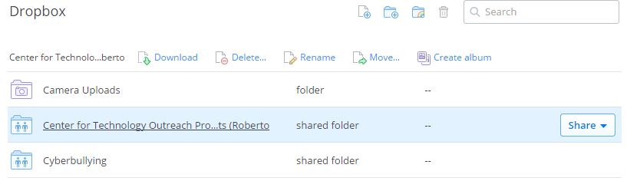
Web Interface
Similar to Internet browsing (click on title to open; on white space beside title to select)
Notice additional options when selected

Slide 36
Upload/Download Files
To upload: click on
To download: select file, click on

Slide 37

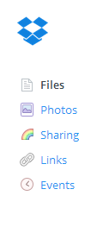
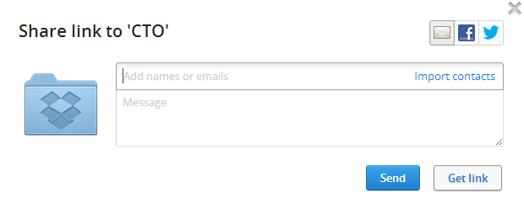
Sharing/Unsharing Files
To share
  Via link to email: click on (to the right of modified date)
  Invite to folder (send invitation via email): click on
To unshare
  Click on links (menu on left sidebar)
  Click on X (beside the date) of file you want to unshare

Slide 38

Editing Office Documents
First, you need to connect the “Microsoft Office Online” for use in Dropbox
Click on title of file to open
From web browser, notice the open icon (top-right corner)
Click on “Open”

Slide 39
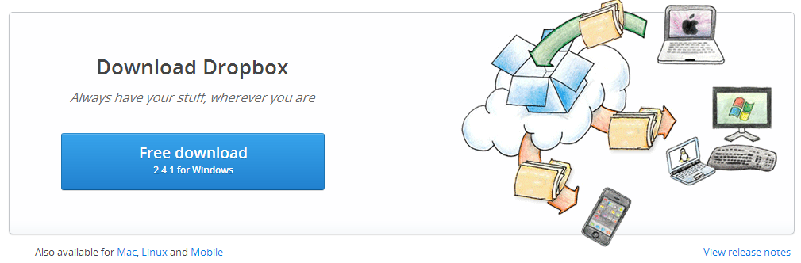
Download Dropbox
Install & configure Dropbox
Creates specific folder that syncs with your Dropbox account
Make sure Dropbox starts on system startup

Slide 40
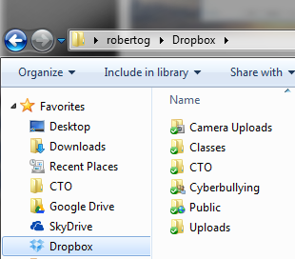

Desktop App
Notice Dropbox option under Favorites (file explorer) once installed and logged in
Green checkmark shows folder is synced

Slide 41
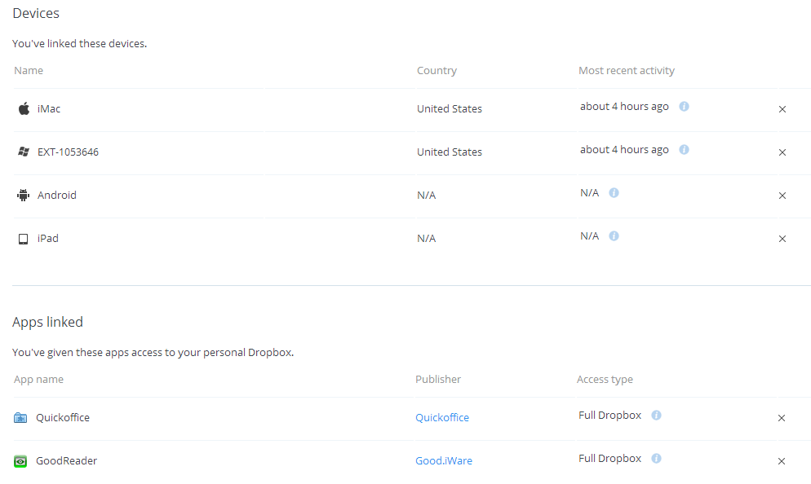
Manage Apps/Devices
Go to dropbox.com → login
Account name (upper right hand corner) → settings → security
Click on “x” to unlink or revoke app access

Slide 42
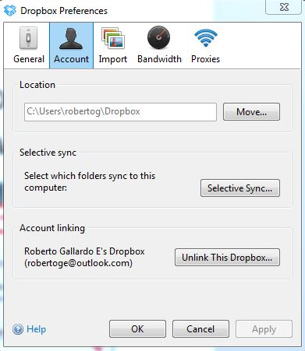
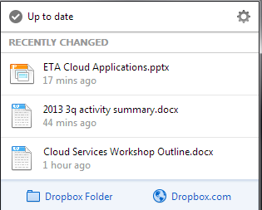
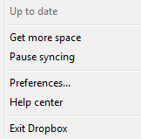
Unlink computer using desktop app
Right-click on icon
Click on gear icon at the top right → preferences → accounts → “Unlink computer”
This will no longer sync your folder with your online account
3
1
2
4

Slide 43
Keep in mind …
There is a web interface and “synced” folder(s) on your computer; if you delete in one place, it will delete in the other
Limited space with free account
Shared folders count towards your space (unless you are part of a business account)
Multiple users can cause issues (unless you have a business account)
Make sure to UNLINK computer/devices from account when no longer in use

Slide 44

Hands-on exercise
Open account
Download/install software
Create folder
Upload file
Share file via link
Unshare file
Create shared folder
Unlink account from computer

Slide 45
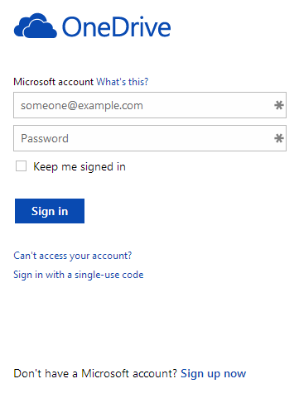
OneDrive
Storage & collaboration application
Requires valid email address (need to open a Microsoft account)
Open account at www.onedrive.com
Allows access to your PC files as well

Slide 46
OneDrive
Web Interface
Upload/Download files
Create files
Sharing files
Download & install app
Unlink devices

Slide 47
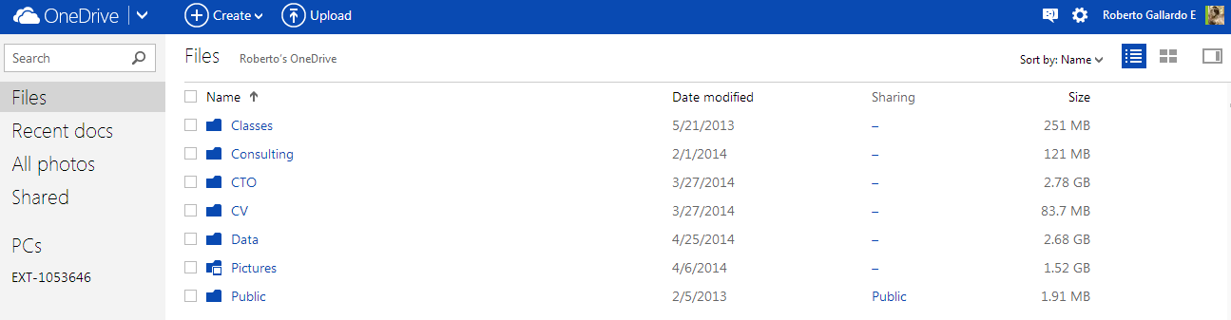
Interface

Slide 48
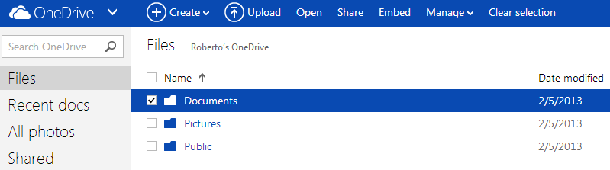
File Explorer
Similar to Internet browsing (click on title to open; on white space or checkbox to select)
Notice additional options at the top when selected

Slide 49


Upload/Download Files
To upload: click on ; follow wizard
To download (does not apply to folders): open or select file, click on
Uses browser’s download options; downloads as Microsoft Office documents

Slide 50

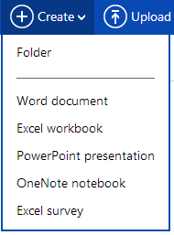
Create Files
Utilizes Office Web Apps (slightly different than the actual Microsoft Office software)
Click on and select file type

Slide 51
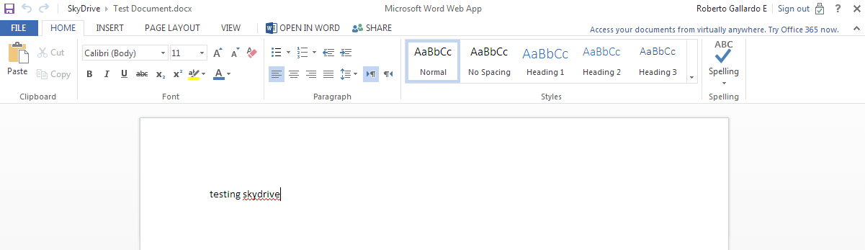
File Management
Notice formatting menus when file is created

Slide 52
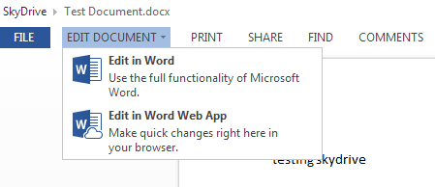
File Management
When working with existing files, enable formatting menus using “Edit Document”
Select “Word Web App”

Slide 53

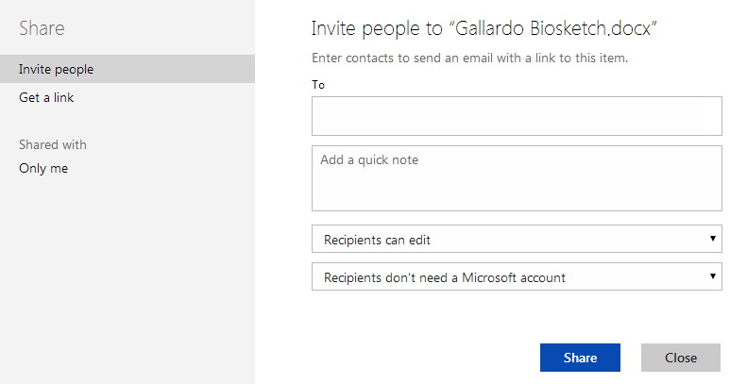
File Sharing
With document open, click on
From the File explorer, select and click on
Invite people via email
  Allow recipients to edit
  Require recipients to
  sign-in
Get a link
  Define settings for those
  with access to the link to
  view only, edit, or public

Slide 54
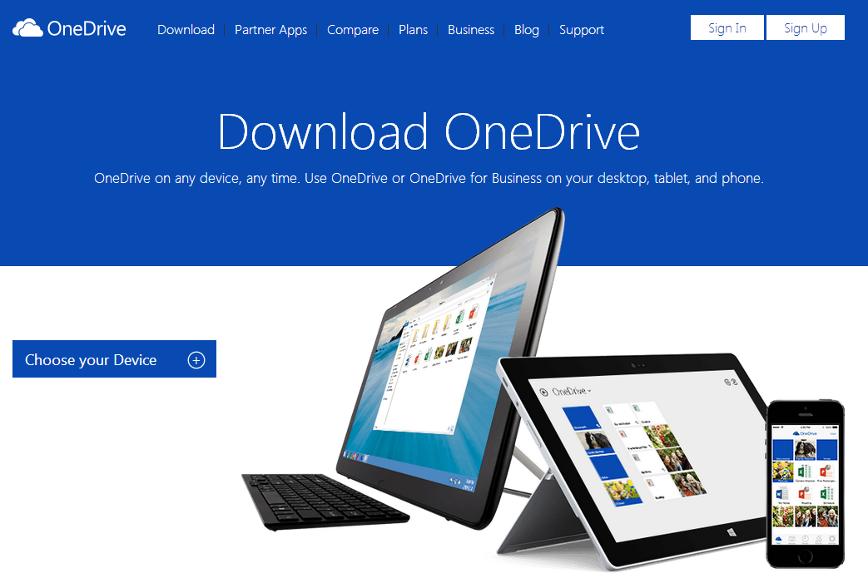
Download OneDrive
Download & install OneDrive
Select folders to sync with account
Fetch files from computer
Make sure OneDrive starts on system startup

Slide 55
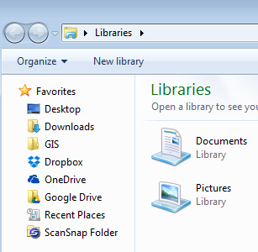
Desktop App
Notice OneDrive option under Favorites (file explorer) once installed

Slide 56
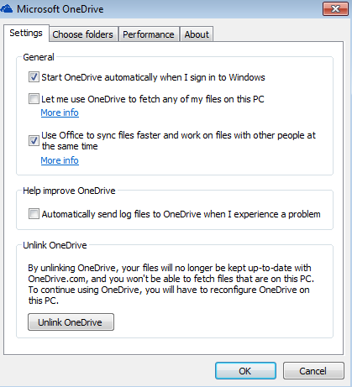
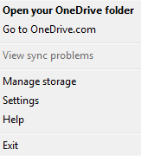
Unlink computer/device
Right-click on OneDrive icon on the taskbar
Click on settings → unlink OneDrive

Slide 57
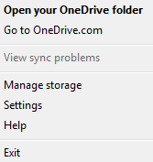
Fetch computer files
Desktop app must be installed and running
Right-click on OneDrive icon → settings
Check “Let me use OneDrive to fetch any of my files on this PC”

Slide 58
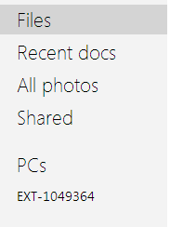
Fetch computer files
Using web interface, click on device name under “PCs” to access any file on linked PC

Slide 59
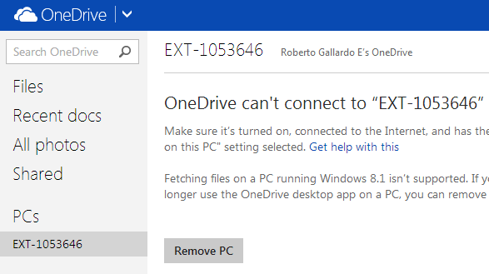
Disable file fetching
On web interface, click on computer name under “PCs” (menu on left side) → Remove PC
1
2

Slide 60
Keep in mind …
There is a web interface and “synced” folder(s) on your computer; if you delete in one place, it will delete in the other as well
Limited space with free account
Multiple users is possible (collaboration)
UNLINK computer/devices from account when no longer in use

Slide 61
Hands-on exercise
Open account
Create folder/file
Upload file
Share folder/file
Collaborate
Download/install software
Delink computer from account

Slide 62

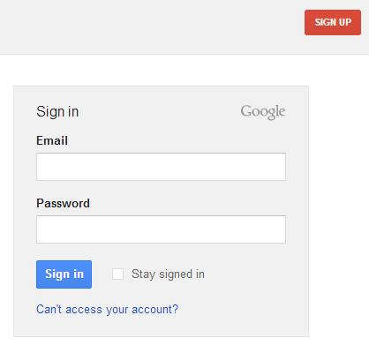
Google Drive
Storage & collaboration application
Requires valid email address (need to open a Google account)
Open account at drive.google.com

Slide 63
Google Drive Content
File Explorer
Upload/download files
Create/Edit files
Sharing files
Download & install app
Unlink devices

Slide 64
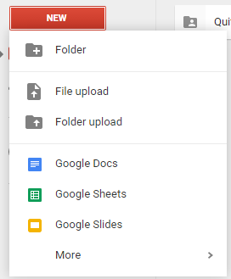
Google Drive?
Two file types: original & Google Docs format (different icons)
Upload/download files
Create files (Google Docs format)
Share files

Slide 65
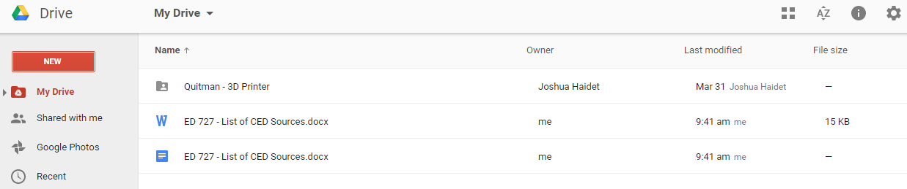
File Explorer
Double-click on files/folder to open; single-click to select
Notice additional options when selected

Slide 66
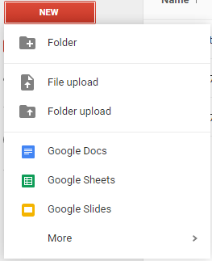
Upload Files
Click on “New” → “Upload file”

Slide 67
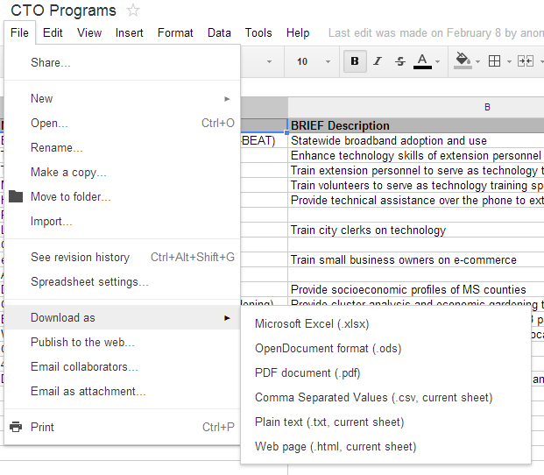
Download Files
Option to download as Microsoft Office files

Slide 68
Create Files
Files are by default in Google Docs format (similar to Microsoft Office)
Add apps to create more files: image editors, diagrams, etc.

Slide 69

Editing Files
If file has a Microsoft Office format, it will automatically save in Google Docs format (this format is compatible)\
Notice different icons

Slide 70
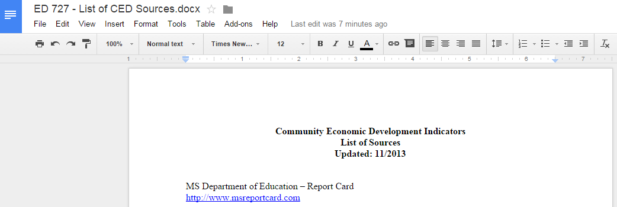
Editing Files
When file is open, notice menu & formatting options

Slide 71
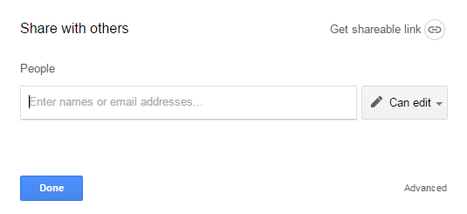
Sharing Files
Two ways to share files:
Inviting people
Sending a link

Slide 72
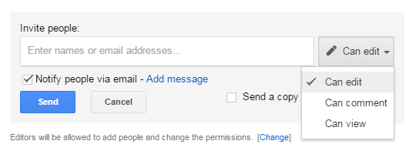
File Sharing
Click-on
Invite people

Slide 73
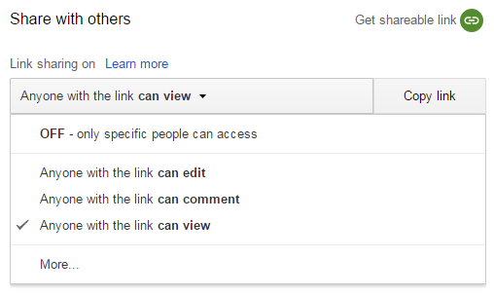
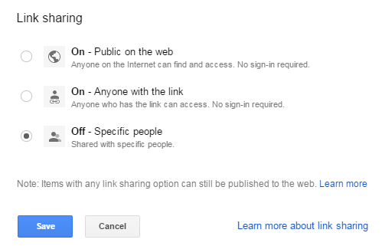
File Sharing
Click on
Send link

Slide 74
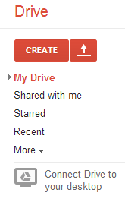
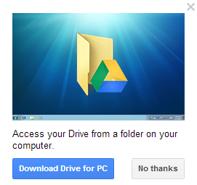
Download Google Drive
Install & configure Google Drive
Select folders to sync with account
Make sure Google Drive starts on system startup

Slide 75
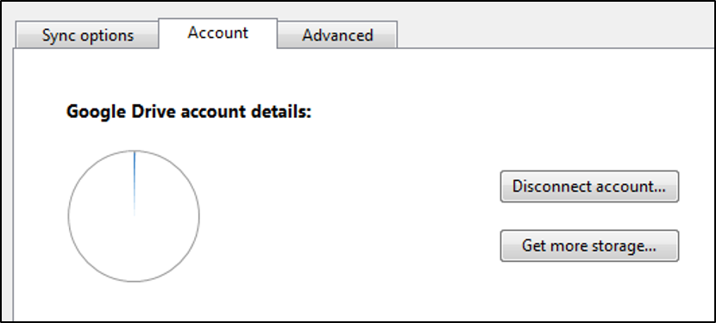

Unlink computer/device
Right-click on Google Drive icon on taskbar
Click on → “Preferences” → Account → “Disconnect account”
This will no longer sync files from your computer to Google Drive

Slide 76
Keep in mind …
There is a web interface and “synced” folder(s) on your computer; if you delete in one place, it will delete in the other as well
Limited space with free account
Multiple users is possible (collaboration)
UNLINK computer/devices from account when no longer in use

Slide 77
Hands-on exercise
Open account
Create folder/file
Upload file (original format)
Upload file (Google Docs)
Share folder/file; collaborate
Download/install software
Disconnect account from devices

Slide 78


Prezi
Online presentations
Requires valid email address
Open account at www.prezi.com
Enjoy, Pro, & Team

Slide 79
Prezi Content
Web Interface
Prezi elements
Adding content
Sharing presentations
Download & install app

Slide 80

Web Interface
Create prezi / edit / share prezi
Filter prezis (created or have been shared with you)
Can create folders

Slide 81



Prezi elements
Templates = can be blank or pre-designed
Canvas = place to put frames and content; can zoom in and out
Frames = PPT slides
Zoom buttons
Transformation tool
Path = sets animation

Slide 82

Adding content

Slide 83

Adding content
Insert

Slide 84

Sharing Prezis
Private
Hidden
Public
Reusable (can save a copy)
Add people (must have prezi accounts)

Slide 85
Desktop App
Download & install

Slide 86

Desktop App
Note the synced and on my computer options
Make sure you work off the synced with Prezi

Slide 87
Hands-on exercise
Open account
Create blank prezi
Add text & images
Add URL & YouTube video
Animate prezi
Share prezi
Download & install prezi app

