Slide 1
Collection Development Resources
Mississippi Library Commission

Slide 2
Print Resources
Booklist
Library Journal
School Library Journal
Publisher’s Weekly
Kirkus
Horn Book Magazine

Slide 3
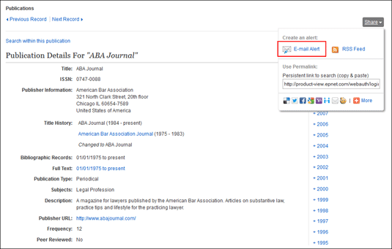
Journal Alerts!

Slide 4
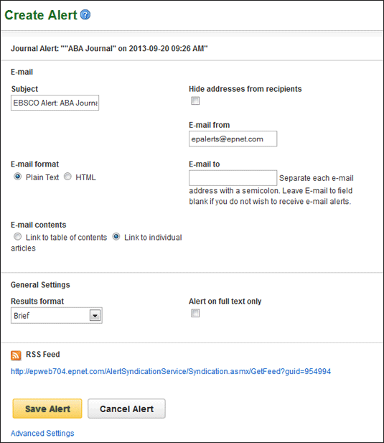
Journal Alerts!

Slide 5
Awards
Caldecott
Printz
Newbery
Nobel
Pulitzer
PEN/Faulkner
National Book Awards
Eisner
Pura Belpré
Hugo
Edgar
Audie
Cybils
Dartmouth Medal
Coretta Scott King
Sydney Taylor
Sophie Brody
Carnegie Medals

Slide 6
Curated Lists
ALSC Children’s Notable Lists
Amazing Audiobooks for Young Adults
YALSA’s Quick Picks for Reluctant Readers
Great Graphic Novels for Teens
Fabulous Films for Young Adults
Outstanding Books for the College Bound
Popular Paperbacks for Young Adults
Teens’ Top Ten
Amelia Bloomer List

Slide 7
Curated Lists
The Listen List
RUSA Notable Books for Adults
Outstanding Business Reference Sources
Outstanding Reference Sources
RUSA’s The Reading List

Slide 8
Ally Watkins
awatkins@mlc.lib.ms.us

