Slide 1
Public Library Statistics
Joy Garretson
State Data Coordinator
601.432.4498
jgarretson@mlc.lib.ms.us

Slide 2
What is this survey and who makes it?
IMLS is the primary source for federal support for libraries and museums. This survey helps to compile the research they do to help us deliver valuable services.
States report their data via WebPlus, which was developed by the Census, who does the final data aggregation.
Use the data to help you look at your library’s functions from year to year.
Look at the inputs (dollars, staff time, etc.) and outputs (number of circulations, visitors, etc.) as a starting point to see if you’re meeting your goals.
Notes:
IMLS: Conducts policy research, analysis, and data collection to extend and improve the nation’s museum, library, and information services.
Once all info is submitted to the WebPlus, the software generates state summary tables (showing state totals for all numeric data number) and single-library tables (showing data for individual public libraries in a state).
Quick discussion of inputs and outputs. If you put in a ton of staff time to YA programs, planned 39 of them, and only 5 kids attended them and didn’t return, then something should be adjusted. (other inputs/outputs/outcomes? Input: sending staff to tech academy; output: staff member teaches one-on-one classes and one tech class a month.; outcome: patrons have higher satisfaction, patrons get a job interview, etc.) This report shows the inputs and the outputs. It’s up to us to gather the outcome information.

Slide 3
Today’s workshop
The new report
Pre-filled or locked items.
Best practices for answering questions.
Changes to the current definitions
Potential new items

Slide 4
Let’s get Started.
http://collect.btol.com
Login/Password
Use Internet Explorer

Slide 5
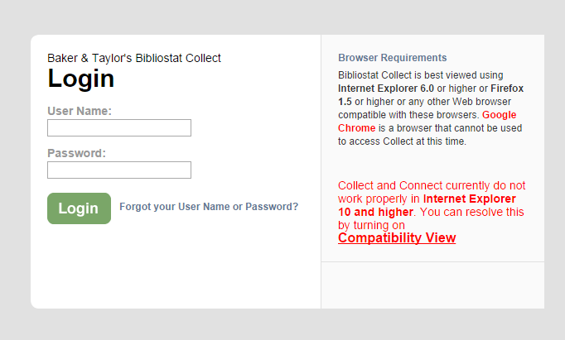
Notes:
I know. It’s ridiculous. Use Explorer.

Slide 6
Things to consider
Frequently mis-reported items last year:
Staff numbers
State grant figures
Reference numbers
Collections
Total items in collection
Circulating E-books vs. Freading
Notes:
As we go through the report online, we’ll address these issues.
Staff numbers was the most problematic issue last year!
Make sure to get your final forms into David for September so that your numbers won’t be off. The huge fluctuations from year to year make our numbers look strange. We want to be able to report to the legislature based on the money that we received (in a timely manner).
Total items in the collection, not total items added this year.

Slide 7
Let’s do a quick math problem!
You have:
7 Employees
4 are librarians. They work a combined total of 95 hours/week.
3 are “other.” They work 50 hours a week.
Tell me:
A) Number of Librarian FTEs
B) Number of Other FTEs
C) Total FTEs
Notes:
This is the Internet’s favorite joke about math teachers.
Discuss definition for librarian/other workers
Math Question:
2.375 (2.38)
1.25
3.625 (3.63)

Slide 8
Operating Revenue
State Grant Info: Make sure to get your September requests for Health & Life Insurance and PIG Payments in on time!
Notes:
More report info—nothing will need much explanation until we get to electronic collections.

Slide 9
Expenditures & Collections
Expenditures
Collections
Make notes about any major changes
If your print/electronic materials/other materials budget has fluctuated, make sure to make a note of this, and consider whether the collection numbers reflect that change.
This should be your total holdings; not just what you’ve added this year.
On question 17.1, you may want to list the databases you purchased
Number of e-books downloaded
Number of music/movies downloaded
=

Slide 10
Revised Data Elements: Electronic Collections
Items that have been purchased, leased or licensed by the library, a consortium, the state library, a donor or other person or entity.
Included items must only be accessible with a valid library card or at a physical library location; inclusion in the catalog is not required.
Do not include items freely available without monetary exchange.
Do not include items that are permanently retained by the patron; count only items that have a set circulation period where it is available for their use.
Count electronic materials at the administrative entity level; do not duplicate numbers at each branch.
Notes:
Free items= project Gutenberg, etc.
These rules apply to all three of the electronic items that we list in your collections—the E-Books, Audio-Downloadables, and Video-Downloadables.

Slide 11
Revised Data Elements
Electronic Books
Digital document (licensed or not), searchable text; analogous to paper book.
Audio-Downloadable
Downloadable files on which sounds are recorded and can be played back electronically.
Video-Downloadable
Downloadable files on which moving pictures are recorded with or without sound. Electronic playback reproduces pictures with or without sound, using a television receiver, computer monitor, or video-enabled mobile device.

Slide 12
All Three:
Loaned to users on portable devices or by transmitting to user’s personal device for a limited time
Held locally or remotely
Report # of units held (including duplicates) at Administrative Entity level.
E-books packaged together & checked out as a unit (several titles on one reader, etc.) = one unit.

Slide 13
Collected E-Books vs. Database E-Books
Lending vs. Keeping = the key here. These are items that are loaned to the user and are not permanently downloaded by them.
For e-content, count only items you have specifically collected (chosen and purchased) for your library from vendors like Overdrive, Baker & Taylor, Amazon, etc.
Some E-book/Music Vendors that will get counted in your Electronic Collections (neé databases) and not in your circulating collection:
Freading
Freegal
I have added a place for you to count patron-driven acquisitions of e-Books, music, and video files.
Notes:
E-Books: Patrons keep these for a limited time. You do not pay for these at the time of download.
Audio/Video:(can patrons access it temporarily or download and keep it forever?)

Slide 14
Library Services

Slide 15
Best Practices Issues
Counting Visits, Internet Use
Public Internet Sessions
Internet Use Surveys
Most systems collect this info 1-2 times per year then multiply for results
Consider:
Splash Page for survey
Using percentages instead
Differ from system to system
Why were the current time limits initially put into place?
No lines and no waiting patrons, but lots of extensions on session times?
Consider making the sessions longer.
Make up for the decrease in stats with increased patron satisfaction and participation in Internet Use surveys
Notes:
Reference Transactions:
Some of these went WAY UP last year. That could be good or bad. You can use the form we gave you, but make sure your staff isn’t counting directional questions as reference questions.

Slide 16
Counting things!
Visits
ILL
Library Visits (manual counts)
Should do these counts at regular intervals
Avoid counting on busiest days unless you’re counting fairly often.
DO NOT USE CONSORTIUM NUMBERS. Only list items requested/received by your library and requested/lent from your library.
If there is a significant change, put it in the notes!

Slide 17
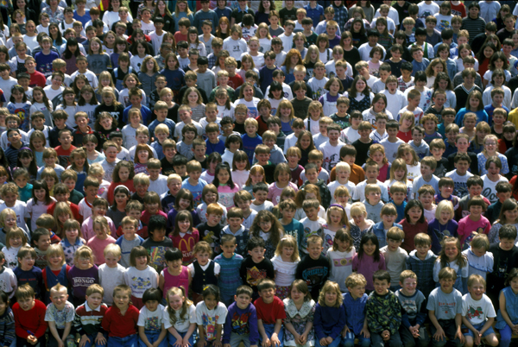
Programming
Adding an early literacy element this year!
This is just a subset of children’s programming.
Notes:
If you go to a class of 25 children, you can count all of those children.
If you go tell a story to 150 children, you can count them! Try not to estimate here—you do want to get a real count, but you CAN count them!

Slide 18
Reporting Wireless Sessions
Wireless Sessions – Annually
Definition: Report the number of wireless sessions provided by the library wireless service annually.
Rationale: Wireless internet service is a key and increasing service of libraries. It makes sense to have a national statistic regarding the level of service to monitor trends and to inform local, state and national broadband policies and initiatives. The information would come from wireless service providers and/or software.

Slide 19
Wi-fi Counting
We’ve got to report this information this year.
For those of you who are in the dark, make an appointment with us! We need to know:
1. What kind of router you have.
2. What kind of website/content management system you have.

Slide 20
Wi-Fi Counting Solutions
Software-Based
Hardware-Based
Cisco Meraki
Between $399-$1399/AP, plus license agreement
https://meraki.cisco.com/
Aerohive
Between $699-$1199/AP, plus license agreement
http://www.aerohive.com/
Open Mesh
Roughly $60/AP, plus router. No license agreement.
http://www.open-mesh.com/
Google Analytics
Free but requires some technical know-how (to build a splash page, etc.)
http://www.google.com/analytics/
Pfsense
$99/year
https://www.pfsense.org/
Who’s on my Wi-fi
$7.95/month ($95.40/year)
http://www.whoisonmywifi.com/

Slide 21
Wi-fi Best Practices
Session length
Sign-in splash page
Internet Use Survey link on that page
Notes:
I would make one person’s session length last no shorter than 2 hours. General discussion has been that some allow a session length to last up to 8 hours.
Some systems just count the number of people connecting. If this is the case with your current software, that’s ok. If you have a chance to upgrade in the future, purchase some software that has more options that go along with it. The new Category 2 Funding parameters will make this more of a possibility.

Slide 22
Dates and deadlines
The 2015 Annual Statistical Report
Release date: October 1, 2015
Due date: December 1, 2015
Drop dead date: February 12, 2016

Slide 23
Upcoming Training:
MLA: Statistics and Infographics for libraries
I’ll share information from the Research Institute for Public Libraries and give out several templates for infographics and telling your library’s story. (This will likely become a webinar, as well.)

Slide 24
Questions?
Joy Garretson
State Data Coordinator
(601)432-4498
jgarretson@mlc.lib.ms.us

